Slide 1
Chapter 10 Lesson 1: A Growing Economy
5th Grade
The Great Depression

Slide 2
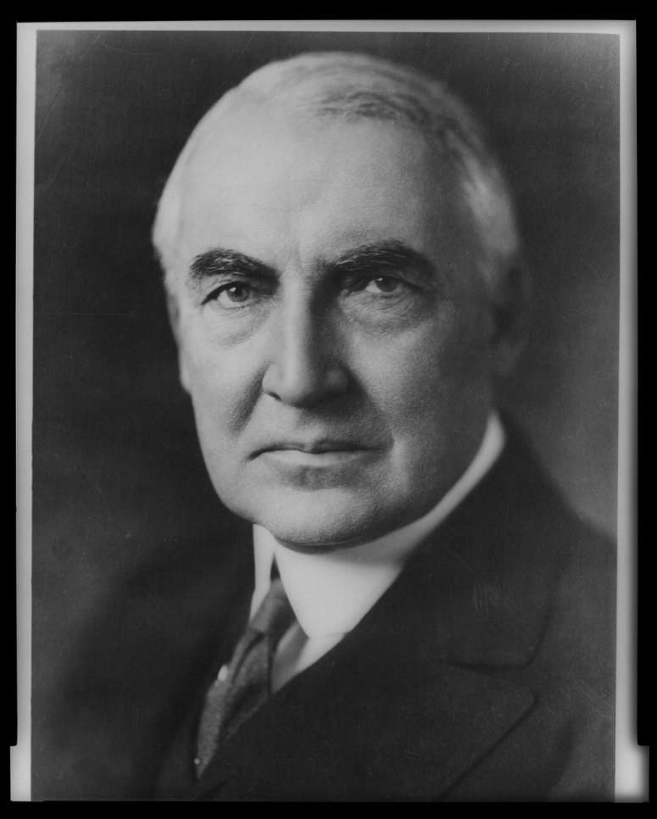
Changes in Production
Warren G. Harding became President in 1920—his message “Back to Normalcy”

Slide 3
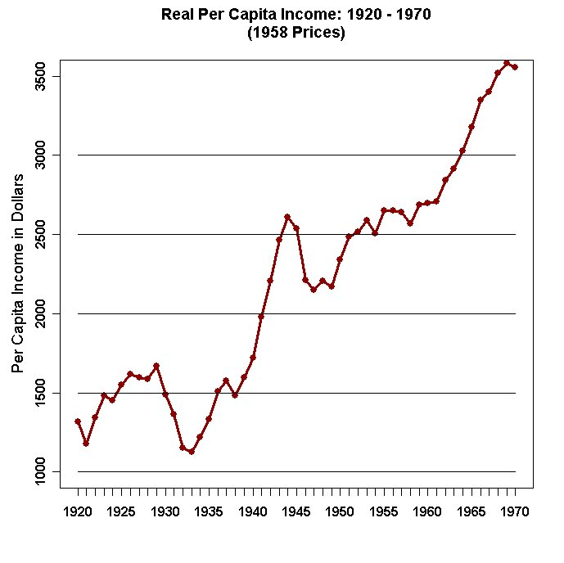
Changes in Production
The economy went through a boom—a period of fast economic growth—after World War I
There was an increase in international trade during and after the war—repayments of debts helped US economy

Slide 4
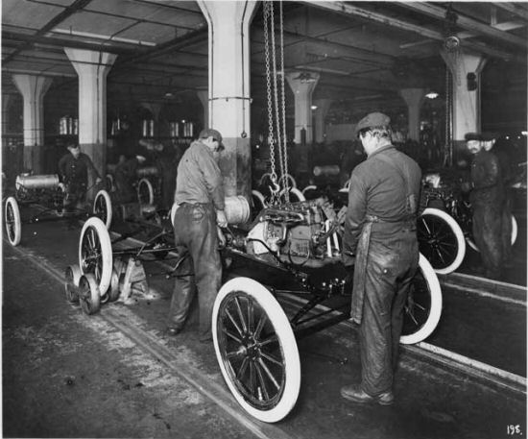
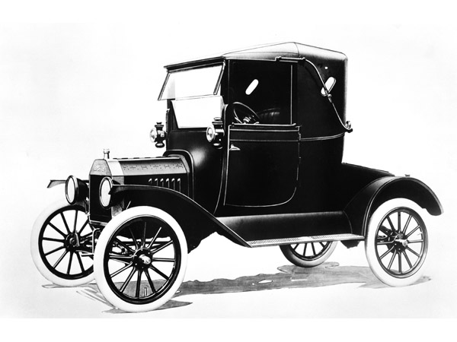
The Automobile Industry
Henry Ford founded the Ford Motor Company
Created a new way to build cars—mass production—using machines to make many products at once

Slide 5
The Automobile Industry
Used an assembly line—a long line of workers and equipment, each doing a specific job
He organized jobs using a division of labor—each worker or group had a small task
It costs Ford less and he could then sell his cars for less. He could pay workers more and still make a profit
More companies followed this idea and this allowed people to buy the goods that were being made—many Americans started to own cars, vacuums, washing machines, toasters, etc

Slide 6
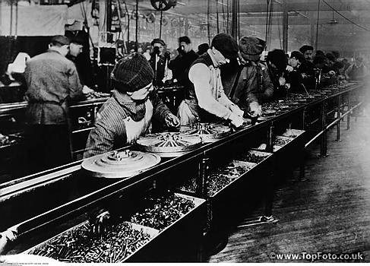

Slide 7
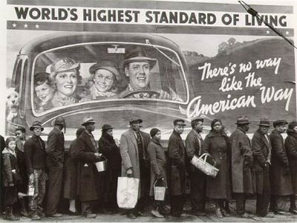

Slide 8
Saving and Investing
Many people began putting money in savings accounts, investing money (to use savings in the hope of earning more money in the future), or in stocks—a share of ownership in a company
Owners of stocks are called stock holders—if the value of a company goes up, or they earn money the stock holder can sell at a higher price. If the price of the stock goes down—the stock holder loses money
The stocks are bought and sold in a stock market

Slide 9
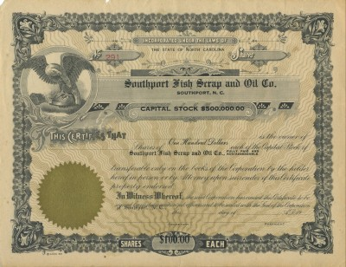

Slide 10
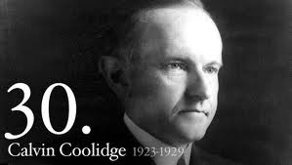
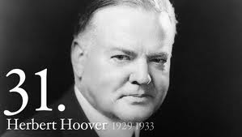
Government in the 1920s
Presidents in the 1920s: Warren G. Harding, Calvin Coolidge, and Herbert Hoover—each a republican and encourages strong economic growth
Coolidge—had the government take in more money than it spent and cut taxes
Hoover—didn’t change much, believed growth came from the hard work of the people

Slide 11
Chapter 10 Lesson 2: The Roaring Twenties
5th Grade
The Great Depression

Slide 12
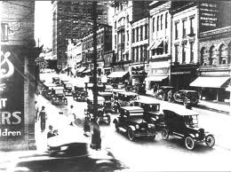
Technology Changes Peoples Lives
People began moving from farms to cities to make money working in factories
The number of cars doubled from 1920 to 1929

Slide 13
Effects of Technology
Cars allowed people to travel longer distances
People could travel, drive to bigger towns for supplies, and allowed for roads to be paved—created gas stations, billboards, and motels
Electricity changed life at home, electric appliances made household chores easier

Slide 14
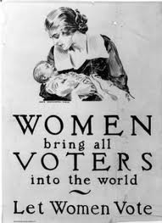
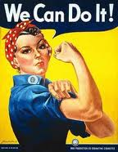
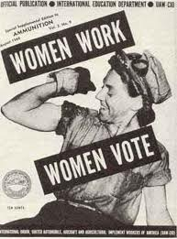
A Changing Society
Known as the Roaring Twenties—things were moving forward quickly
Women were playing sports, going to college, working, driving cars, flying airplanes
The 19th Amendment was ratified—allowing women the right to vote

Slide 15
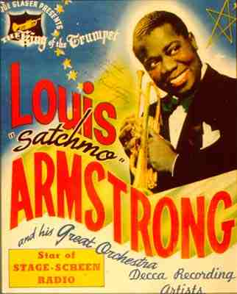
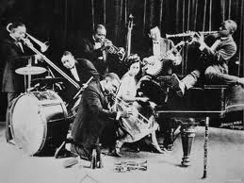
Jazz
Jazz became popular—a style of music that uses a lot of improvisation, they decided what they were playing as they played

Slide 16
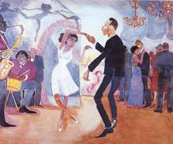
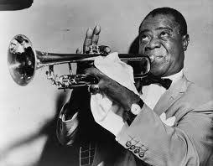
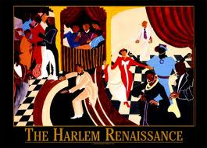
Harlem Renaissance
Louis Armstrong—a singer and trumpeter—helped in creating the Jazz Age
African Americans helped bring this about—Harlem, NY was especially known for this style of music
Langston Hughes was a famous poet during this time (the Harlem Renaissance— was a time when there is new interest in art, literature, music, and learning)

Slide 17
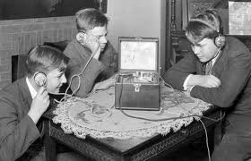
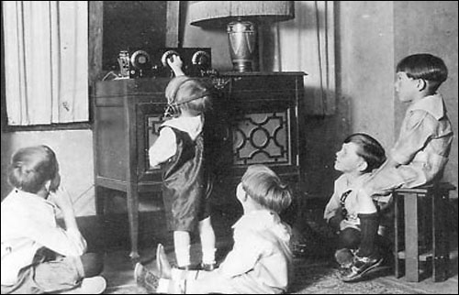
New Kinds of Entertainment
The first Radio broadcast—a program sent out over radio or television station—was in 1920
Station KDKA reported Warren Harding was elected president
Families gathered to listen to music, comedy shows, news reports, mystery stories, and commercials

Slide 18
New Kinds of Entertainment
People were able to hear sports broadcasts of:
Babe Ruth—he was the first baseball player to hit 60 home runs in a season
Jack Dempsey—who fought fearlessly in the boxing ring
Helen Wills Moody—a famous tennis player, winning her first tournament at 17 years of age
Hollywood also created over 700 films—at first they were silent, in 1927 there was sound

Slide 19
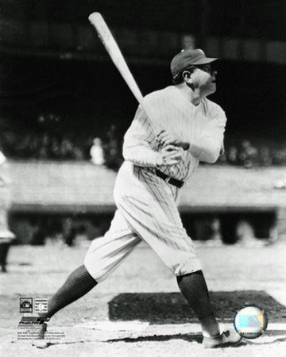
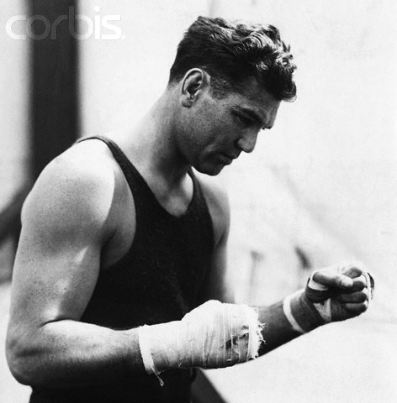
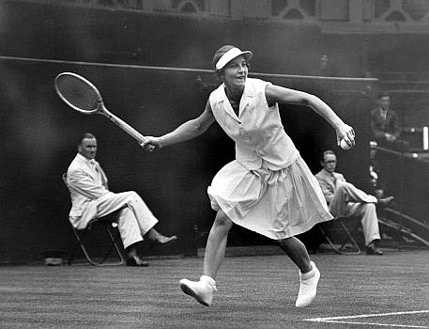

Slide 20
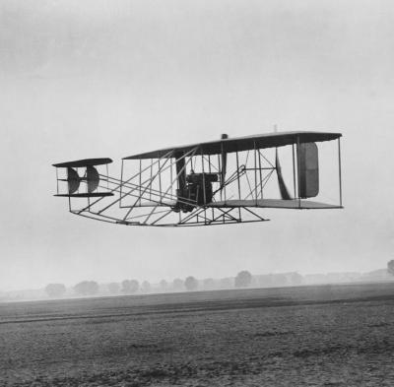
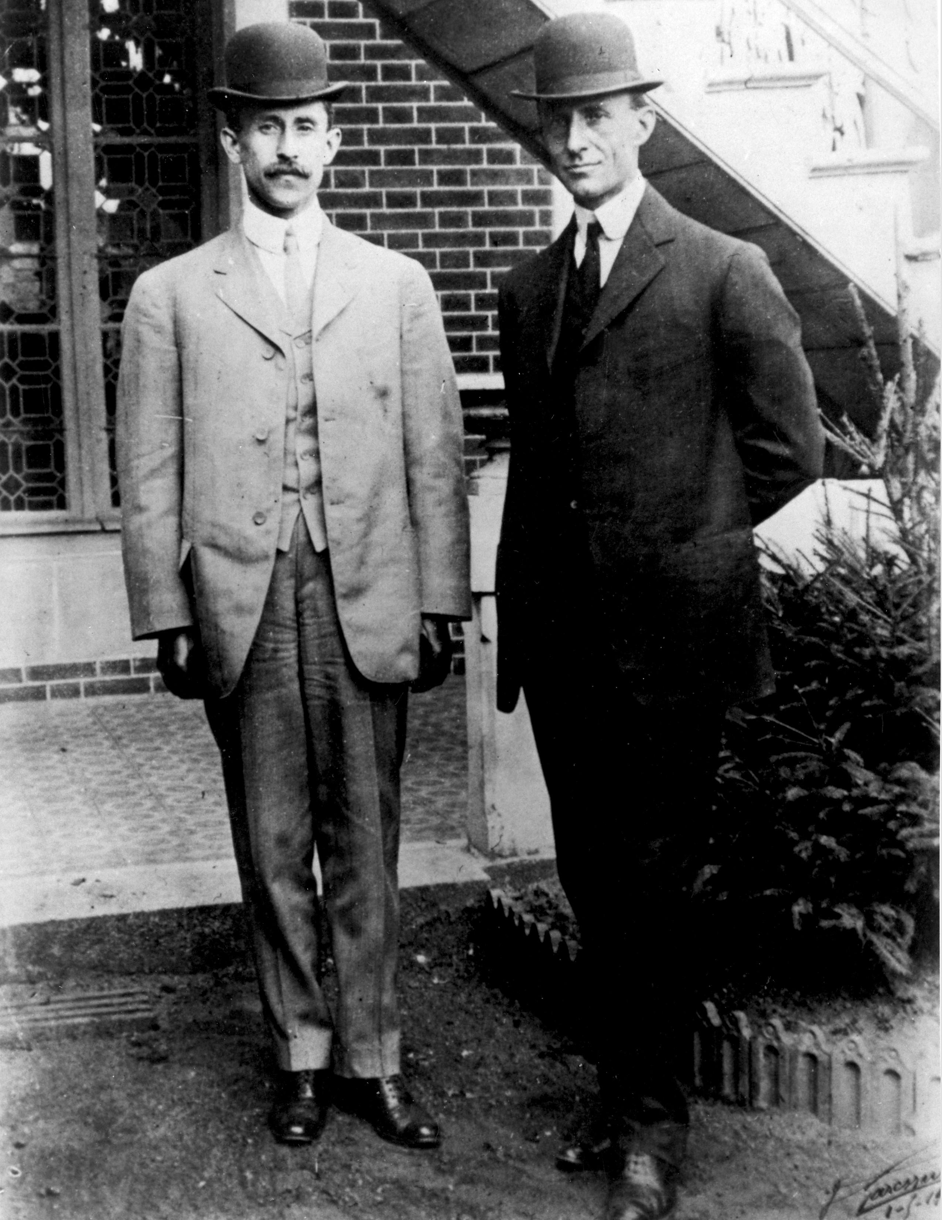
Wright Brothers
In 1903 the Wright Brothers made the first airplane flight in Kitty Hawk, North Carolina
Aviators—a person who flies an airplane—began flying long distances

Slide 21
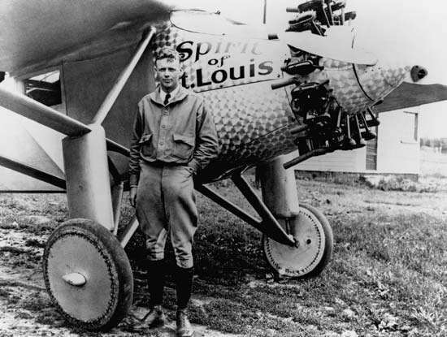
Early Aviators continued…
Charles Lindbergh was the first person to fly alone across the Atlantic Ocean

Slide 22
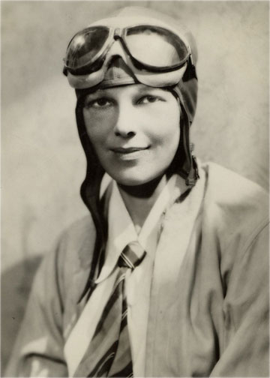
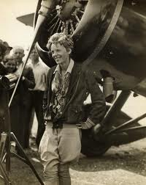
Early Aviators continued…
Amelia Earhart set many records and inspired many women

Slide 23
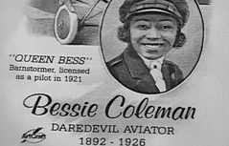
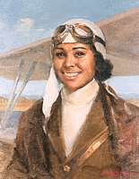
Early Aviators continued.
Bessie Coleman was the first African American to earn a pilot’s license (1921)—she learned in France because American schools would not teach her

Slide 24
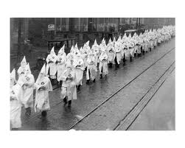
Problems of the 1920s
Many still faced prejudice—a group called the Ku Klux Klan spread hatred against others—they dressed in robs and killed people they felt were “un-American”

Slide 25
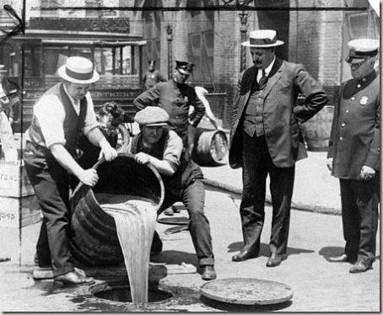
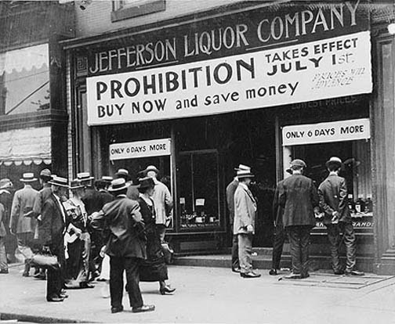
Prohibition
The 18th Amendment made selling and drinking alcoholic beverages against the law—a period in time called the Prohibition Era
People often still made and sold alcohol which increased crime and violence

Slide 26
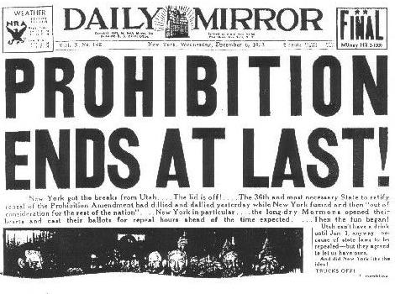
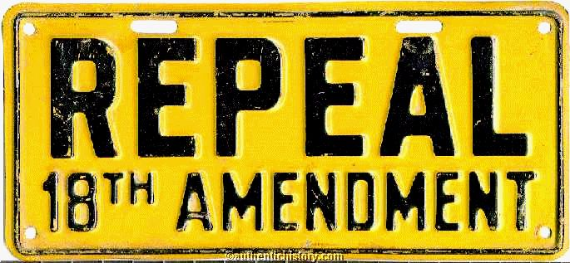
Prohibition
The 21st Amendment repealed, or ended, this act in 1933
Farmers also struggled in paying back loans they got during the war, once the war was over

