Slide 1
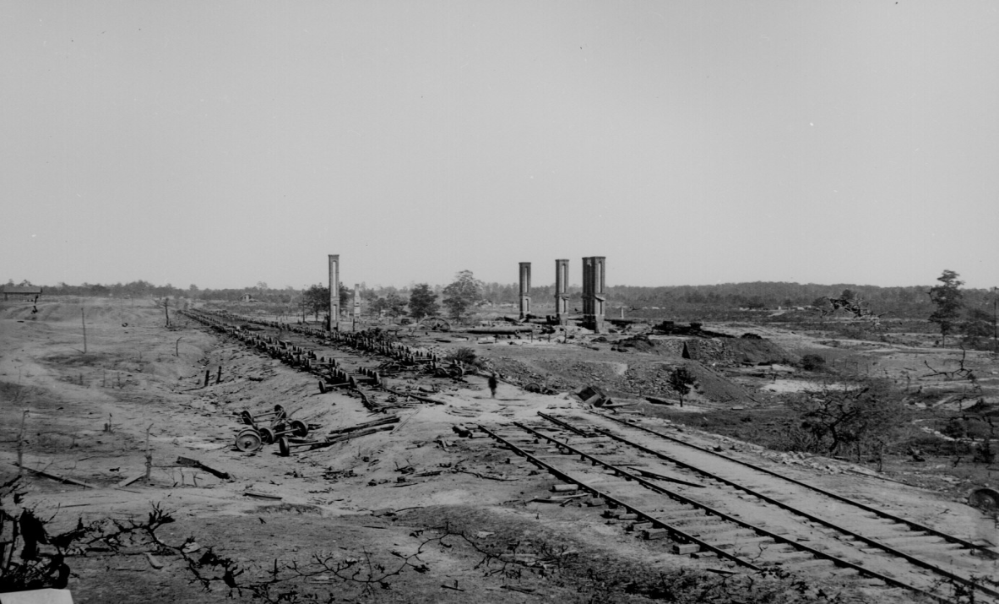
Chapter 6 Lesson 2
The Human Face of War
Pgs. 184-187

Slide 2
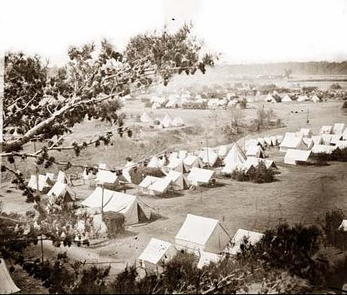
The Soldier’s Life
Soldiers thought it would be exciting, but soon realized it was scary and boring at times in the camp.
They read, sang and wrote letters to pass time.
Food was NOT good.

Slide 3
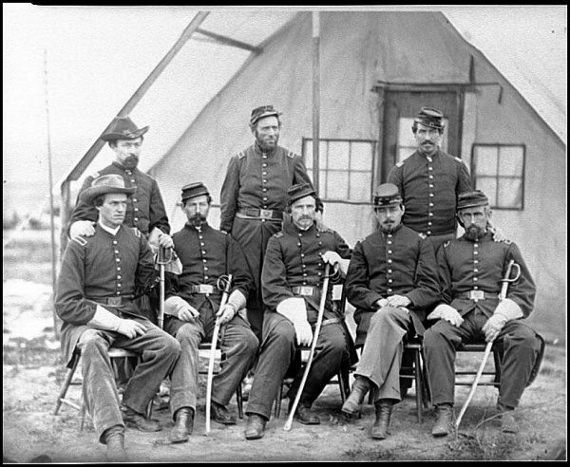
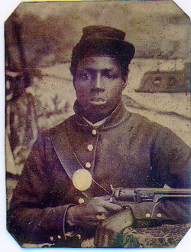
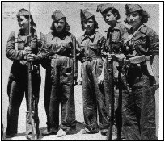
Who were the Soldiers?
At the beginning, they were white and American born
Union allowed African Americans and immigrants to fight
Both sides allowed American Indians to help
Young boys were drummer boys to send signals
Women dressed up like boys or be spies

Slide 4
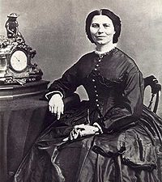
Casualties of the War
Deadliest War in American History
Disease killed twice as many people as fighting
Women helped take care of the sick and wounded
Clara later founded the American Red Cross

Slide 5
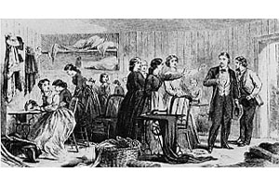
On the Home Front
Women took on new tasks while the men were gone
They sewed uniforms, made bandages and raised money
Photography allowed those not close to the war in the North to know what it was really like

Slide 6
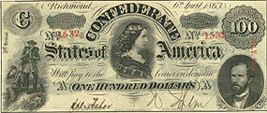
The Southern Home Front
Farms became battlefields
Cities, homes, and barns were destroyed
What is an example?
Not enough food to eat, Women started attacking shops in search of food to eat.
Confederate money became worthless
Flour was $6 in 1861 and $1,000 in 1865

Slide 7
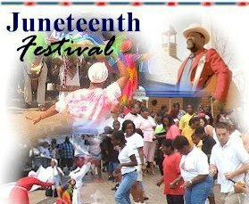
The Emancipation Proclamation
Many enslaved people did not know about it until the END of the War!!
June 19, 1965 – news reached Texas about the EP and was celebrated… now known as Juneteenth and is still celebrated today

