Slide 1
Chapter 7, Lesson 3: Cattle Ranchers
Pages 238-241
Time Period: 1865-1980

Slide 2
Texas Cattle (page 238)
In the 1860’s ranchers raised and sold longhorn cattle that lived on the Texas plains.
Vaqueros (Mexican cowhands) taught their methods of herding on horseback to other cowhands and ranchers in the Southwest
Click here to check out a real cattle ranch!

Slide 3
Demand and Supply (page 239)
Cattle was in greater demand (the amount of something that people want to buy at certain prices) in the eastern and northern United States ($4 in Texas versus $40 in the east and north.
Supply (the amount of something that people want to sell at certain prices)
Vocabulary Words: supply and demand → continue to next slide to learn more about supply and demand.

Slide 4
Demand and Supply for Cattle continued…(page 239)
Prices for goods are set by using supply and demand
REMEMBER…
The MORE supply the LESS the cost
The LESS the supply the GREATER the cost.
Learn more about supply and demand by clicking → here.

Slide 5
The Cattle Drives (page 239)
Ranchers sent their cattle to railheads (towns where the railroad tracks begin or end
The cattle were loaded onto trains and shipped to cities in the north and east
Cowhands had to lead the cattle hundreds of miles from ranches in Texas to railheads – cattle drives
These cattle drives took weeks or months to complete!
Watch a video on cattle drives click → here.

Slide 6
The Cattle Drives continued… (page 239)
Used trails where water and grass were available
Shawnee Trail – San Antonia → Kansas City
Chisholm Trail – San Antonio → Newton, Abilene, or Ellsworth
Great Western Trail – Bandera → Dodge City or Ogallala
Goodnight – Loving Trail – Fort Concho → Pueblo, Cheyenne, or Denver
Click→ here to watch a video on the Cattle Drive Trails.

Slide 7
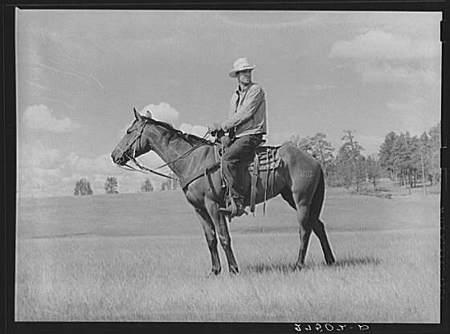
Life on the Drives (page 240)
Cattle drives were dangerous, boring, and dirty
Spent 10-14 hours per a day on horseback
Slept on the ground
Had to guard the heard at night to protect the cattle from thieves and animals.

Slide 8
The End of the Drives (page 241)
Invention of barbed wire (twisted wire with sharp barb, or point, every few inches
Blocked the cattle trails
Growth of the railroads
Railheads were nearby to ship cattle
Not enough grass to feed all the cattle
A terrible winter in 1886-1887 killed thousands of cattle
Click → here and here for a video on the Cattle Drives.

