Slide 1
Chapter 8 Lesson 1: The Rise of Big Business
Pages 258 – 265
Time Period: 1865-1900

Slide 2
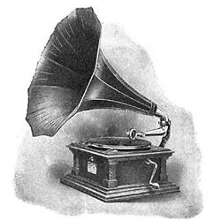
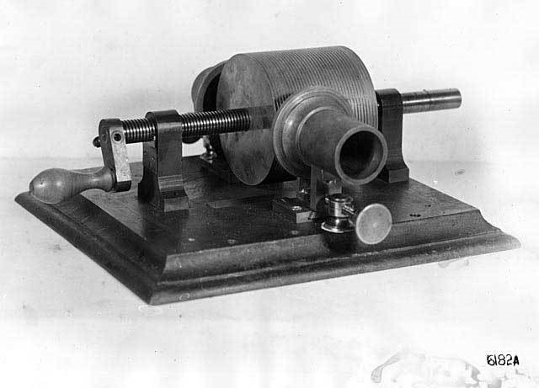
A Time of Invention
New Inventions saved people time, money, and improved life.
People could now do things that were impossible to do before, such as recording sound.

Slide 3
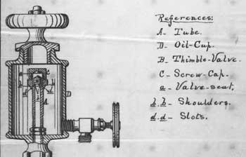
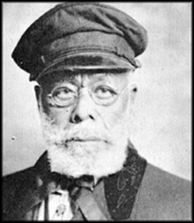
Inventions for Home and Work
1872 – Elijah McCoy – invented an oil cup, allowed trains and machines to run longer by dripping oil over moving parts

Slide 4
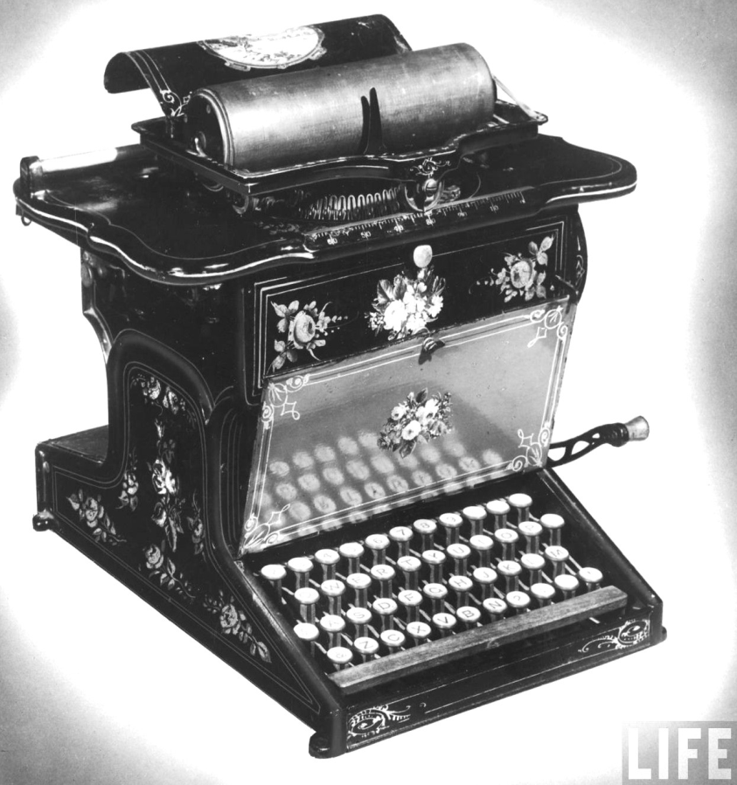
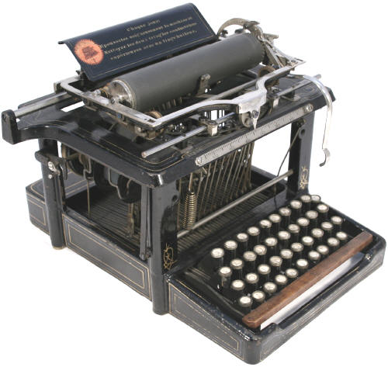
Inventions for Home and Work
1875 – E. Remington and Company
Made and sold typewriters
Saved office workers time

Slide 5
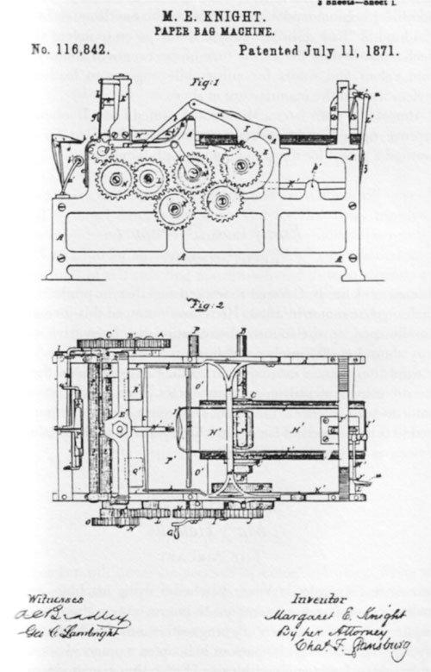
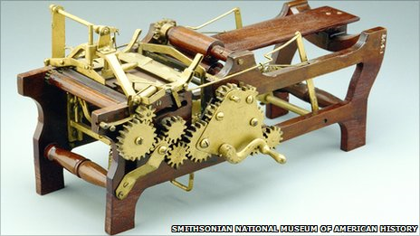
Inventions for Home and Work
1867 – Margaret Knight
Made paper bags with a bottom
Were able to hold more

Slide 6
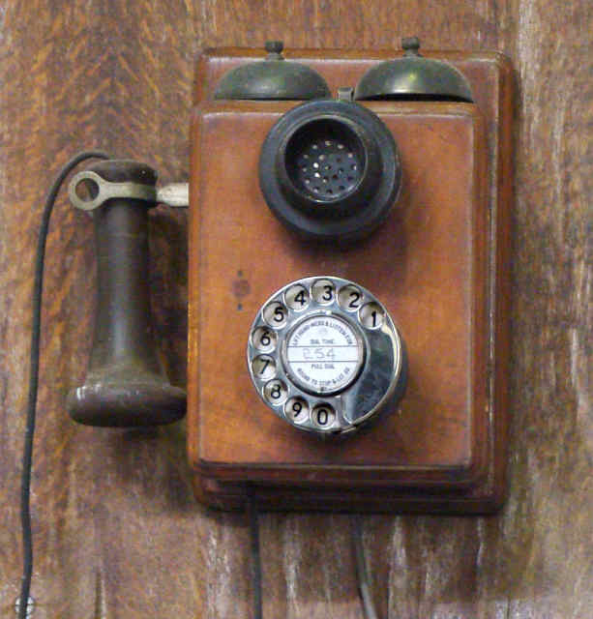
Inventions for Home and Work
1876 – Alexander Graham Bell – invented the telephone
Used by businesses to
talk to workers on
different floors
Used by people at home
to talk to family and friends
many miles away

Slide 7
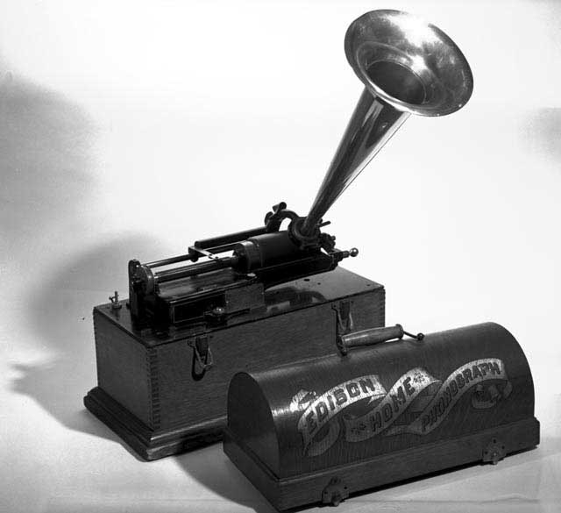
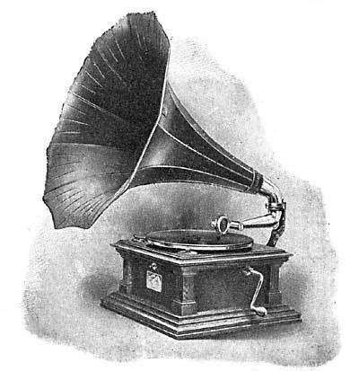
Inventions for Home and Work
1877 – Thomas Edison
Invented the phonograph (record player)

Slide 8
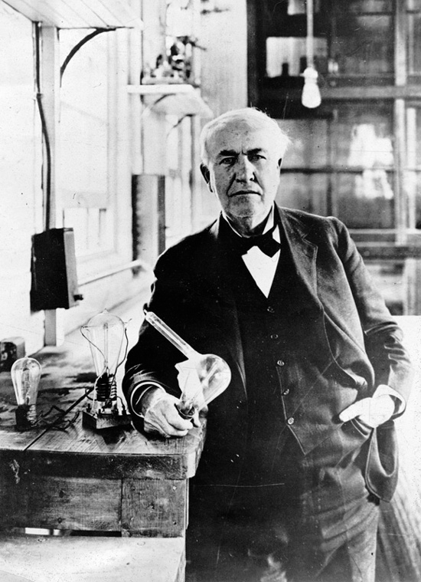
Inventions for Home and Work
1879 – Thomas Edison – invented the electric light bulb
Cleaner and safer than gas
lamps
Allowed factories and shops
to stay open after dark

Slide 9
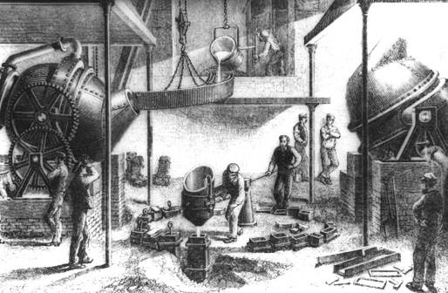
Big Business
1865 – Henry Bessemer – invented a process to make steel (Bessemer Process)
Made steel much less expensive to produce

Slide 10
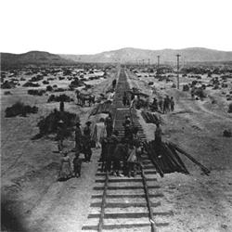
Big Business (continued)
Andrew Carnegie built a factory to use the Bessemer Process to make steel rails for railroads
Carnegie also bought fuel
companies, railroads, and ships –
this allowed him to lower the
price he paid for getting fuel for
his factories as well as shipping costs

Slide 11
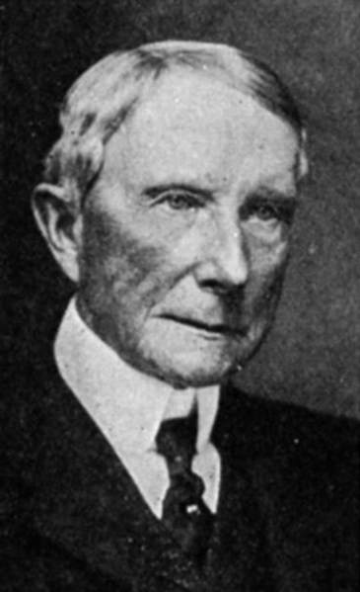
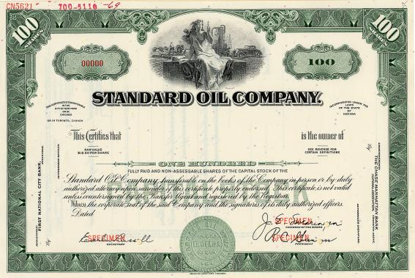
Corporations
John D. Rockefeller
founded Standard Oil Company (1870)
Made products such as fuel and lamp oil
Standard Oil Company was a corporation, a business where many people own shares, or parts of the business

Slide 12
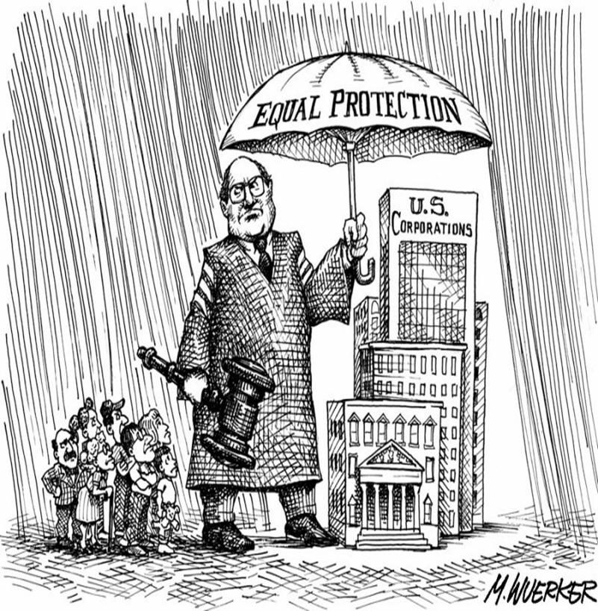
Corporations (continued)
Corporations pay part of their profits, the money earned after all costs are paid, to share owners

Slide 13
Companies Grew Larger
Corporations grew larger by selling stocks to raise money
Corporations were able to build factories and buy expensive machines with the money
Small businesses could not afford to purchase machines or build factories
Standard Oil Company grew by buying more oil companies

Slide 14
Companies Grew Larger (cont’d.)
Rockefeller bought the companies to reduce competition – when more businesses try to sell the same goods or services
Competition allows prices to remain low and quality high for consumers

Slide 15
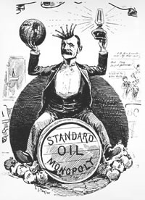
Companies Grew Larger (cont’d.)
Standard Oil Company became a monopoly because it bought so many companies
Monopoly – a company that has no competition

Slide 16
Worker’s Lives Change
Machines were used to speed up the process of producing goods
Good could not be sold at lower prices for people to buy so businesses made more goods and hired more people
Factories had unsafe working conditions and many workers were injured or killed in accidents.

Slide 17
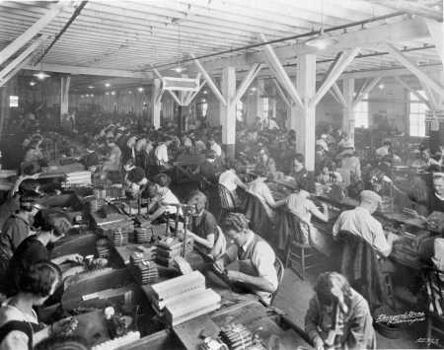
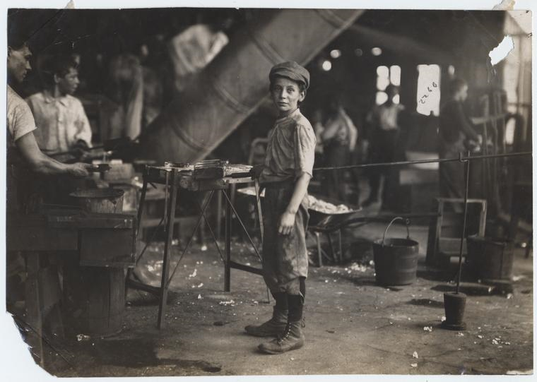
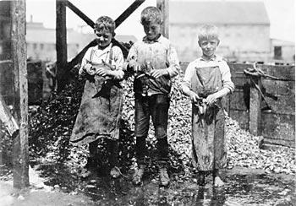
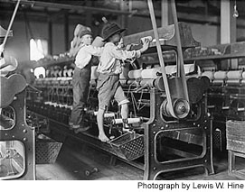

Slide 18
The Labor Movement
Workers were paid poorly
Worked for 10-12 hours / day
Many children had to work to help their families earn money
Workers were fired for complaining about working conditions

Slide 19
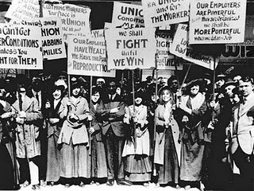
The Labor Movement
Labor Unions, an organization of workers that tried to improve pay and conditions for its members, were formed

Slide 20
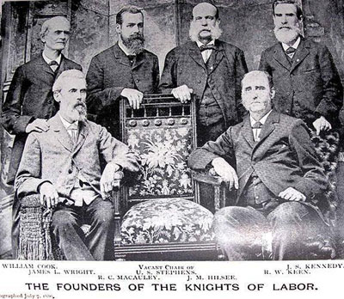
1869 – Knights of Labor was formed
Wanted to:
Make safer working conditions
8 hour work day
Stop hiring children

Slide 21
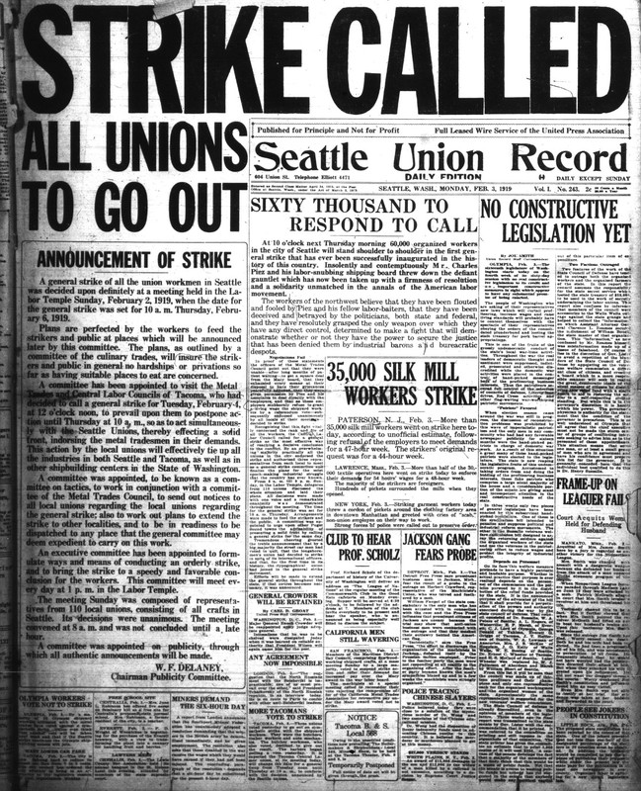
STRIKE!
Unions used strikes (when workers refused to work) to try to force businesses to make changes

Slide 22
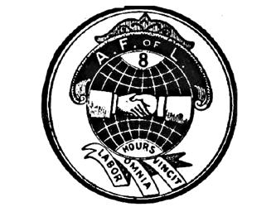
1886 – American Federation of Labor (AFL)
Formed a large group of trade unions (organization of workers who do same types of jobs)
Samuel Gompers elected President of AFL
Wanted:
Better wages
Safer conditions
Shorter workdays

Slide 23
Labor Unions
First labor unions failed
People were hurt or killed in fights between police and strikers
Monopolies blocked progress for workers

