Slide 1
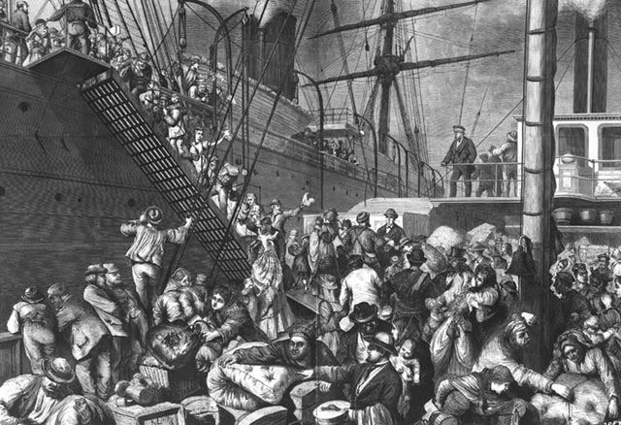
Chapter 8, Lesson 2: Immigrants in America
Pages 266-269
Time Period: 1880-1924

Slide 2
Arriving in America
About 25 million immigrants moved to America between 1880-1924
Before 1880 immigrants came from northern or western Europe (Ireland, Germany, England, Sweden, Denmark)
After 1880 – immigrants came from southern and eastern Europe (Italy, Russia, Hungary, Greece, Poland)
Immigrants came for work and to escape war or persecution (unfair treatment or judgment)
Jews in eastern Europe were hurt or killed because of their religion.

Slide 3
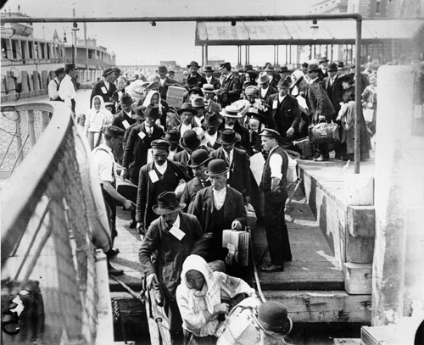
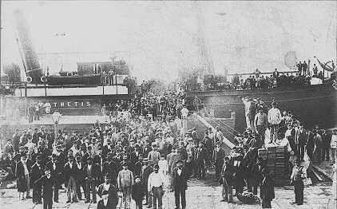

Slide 4
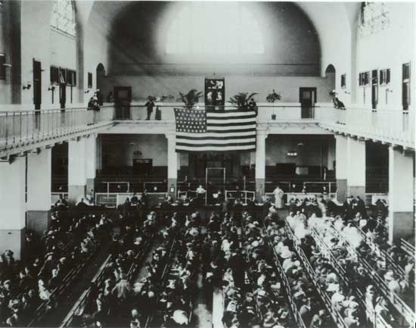
Immigrant Stations: Ellis Island
European Immigrants arrived here
In New York harbor
Government asked immigrants where they planned to work and live
Examined by doctors for diseases
Almost all were allowed to enter

Slide 5
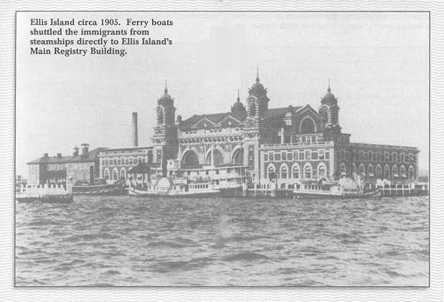

Slide 6
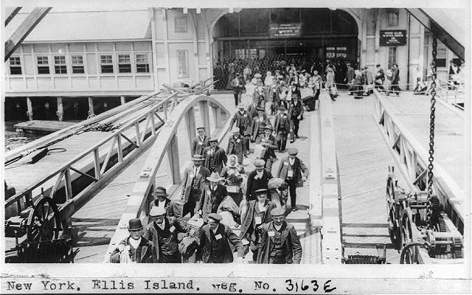

Slide 8
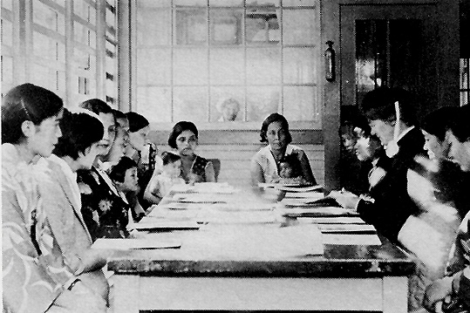
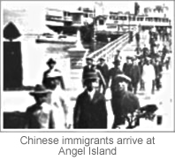
Immigrant Stations: Angel Island
San Francisco Bay
Chinese and Asian Immigrants arrived here (1850s)
Faced more prejudice
Had to stay for weeks, months, years before entering the U.S.
About 35% had to return to their home countries

Slide 9
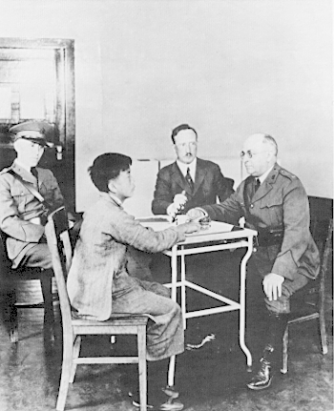
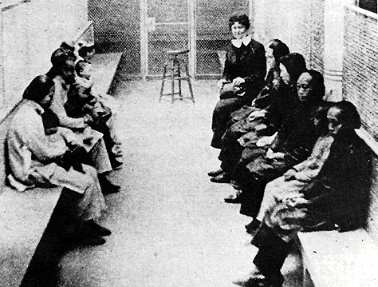
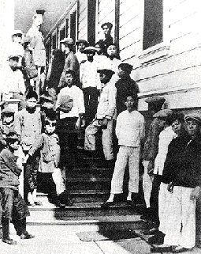

Slide 10
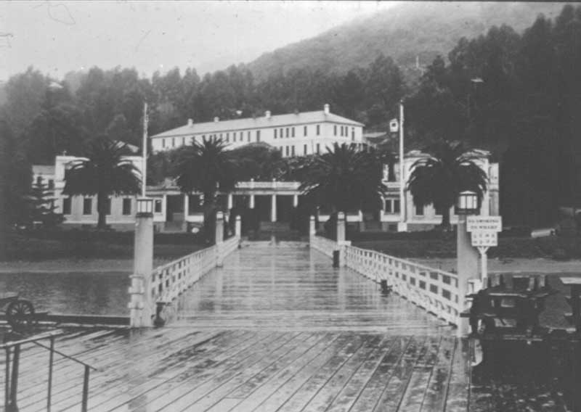

Slide 11
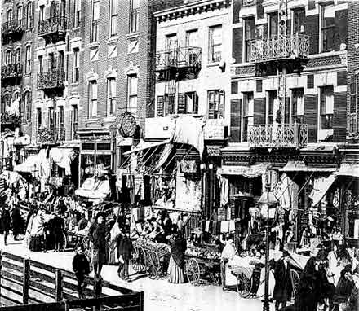
Living in a New Country
Immigrants settled near family and friends
Entire neighborhoods were made up of one ethnic group (a group of people who share the same culture)
Immigrants spoke their native language, practiced their religion, and kept their country customs.

Slide 12
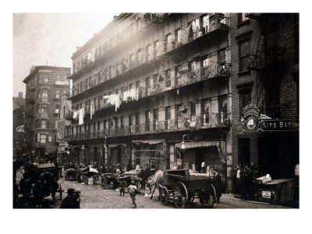
Living in a New Country (cont.)
Immigrants worked in dangerous steel mills, noisy and dirty factories
They worked long hours for little pay
Lived in tenements
Poorly built apartment buildings
Crowded
Unsafe
Often had no windows
Several families lived in
one small apartment

Slide 13
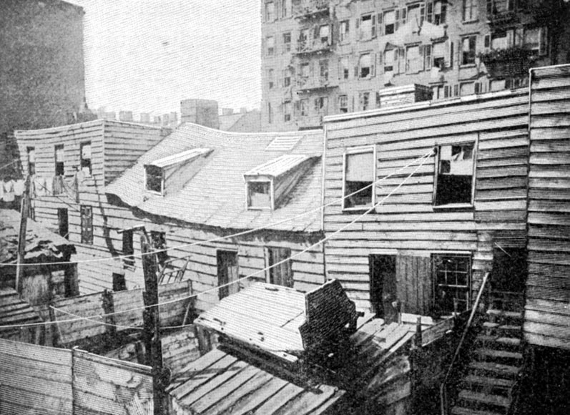

Slide 14
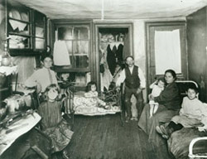
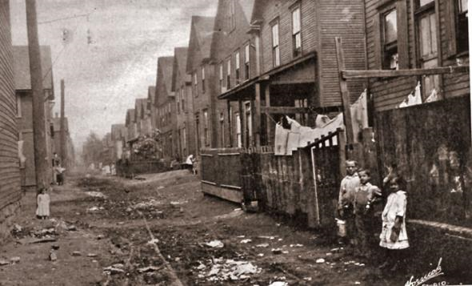
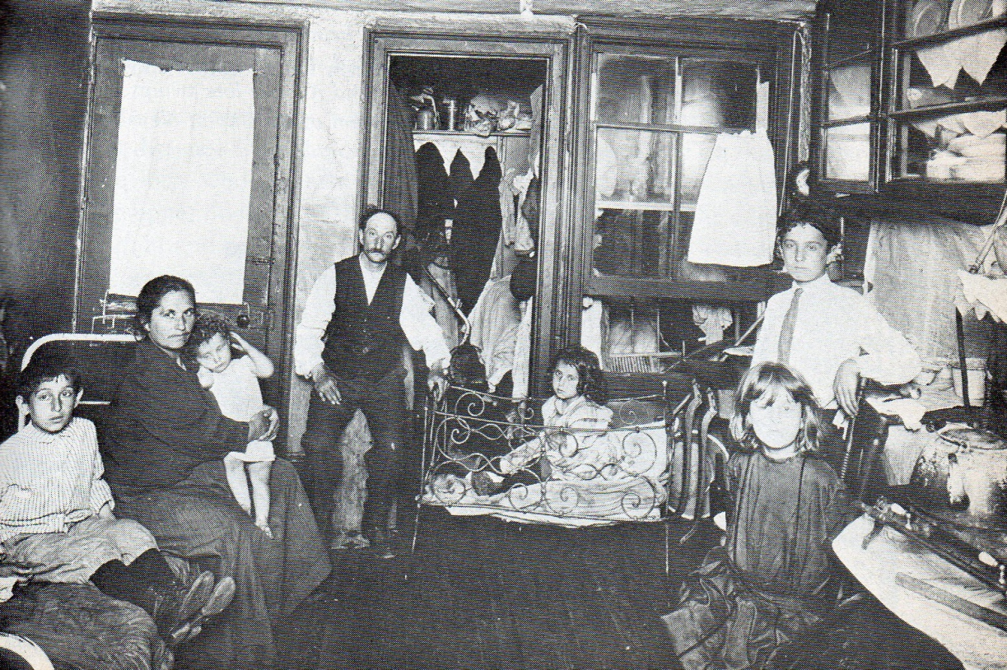

Slide 15
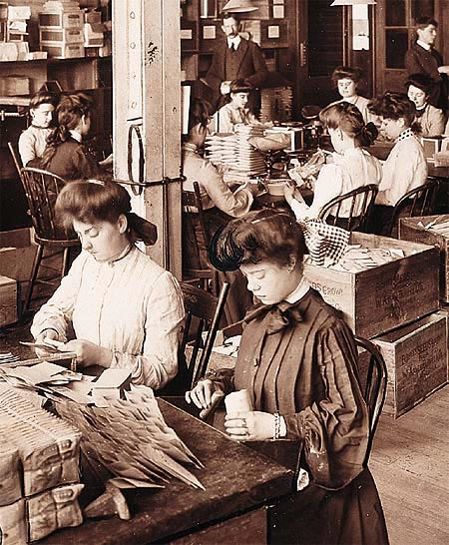
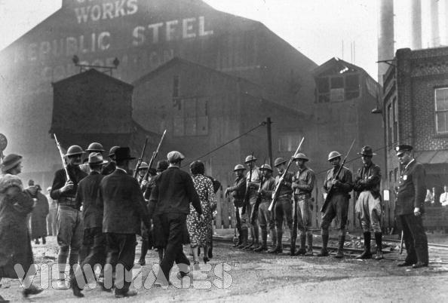
Hard Times for Immigrants
Immigrants faced prejudice because people were frightened by unfamiliar languages and customs
Employers like immigrants because they worked hard for little money
People wanted to stop immigration because they were afraid of losing their jobs to immigrants

Slide 16
Laws Against Immigration
1882 – Chinese Exclusion Act – kept out almost all new Chinese Immigrants
1921-1924 – Congress passed laws that greatly lowered the number of Europeans and kept out most Asians from the U.S.
Immigrants over came hardships to help the U.S. become one of the richest and fastest growing countries in the world
Immigrants built railroad tracks, dug coal mines, and worked in factories

Slide 17
Websites
Brain pop video on immigration click → here.
A Day in the Life of an Irish Immigrant boy click → here.
Ellis Island Virtual Field Trip Click → here.
Angel Island story click → here.
Immigrant Stories : Then and Today click → here.
Stowaway! Activity: Virtual Trip click → here.
Ellis Island- Discovery Education Video click → here.
Life as an Immigrant – Discovery Education video click → here.
Immigration to the U.S. – Discovery Education video click → here.

