Slide 1
Chapter 9 Lesson 1 New Territories
(pgs. 296-301)
Time period
1867-1914

Slide 2
The Nation Expands
The nation found new ways to expand
Alaska
Hawaii
Spanish American War
Cuba
Panama Canal

Slide 3
ALASKA
1867- Secretary of State William Seward convinced Congress to purchase Alaska from Russia
Many Americans thought it was a terrible idea (“Seward’s Folly”)
1896- miners found gold in Alaska
The fish, forests, and minerals were worth much more than its gold
1912- Alaska became a territory
1959- became the 49th state

Slide 4
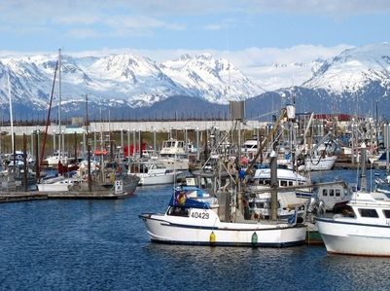
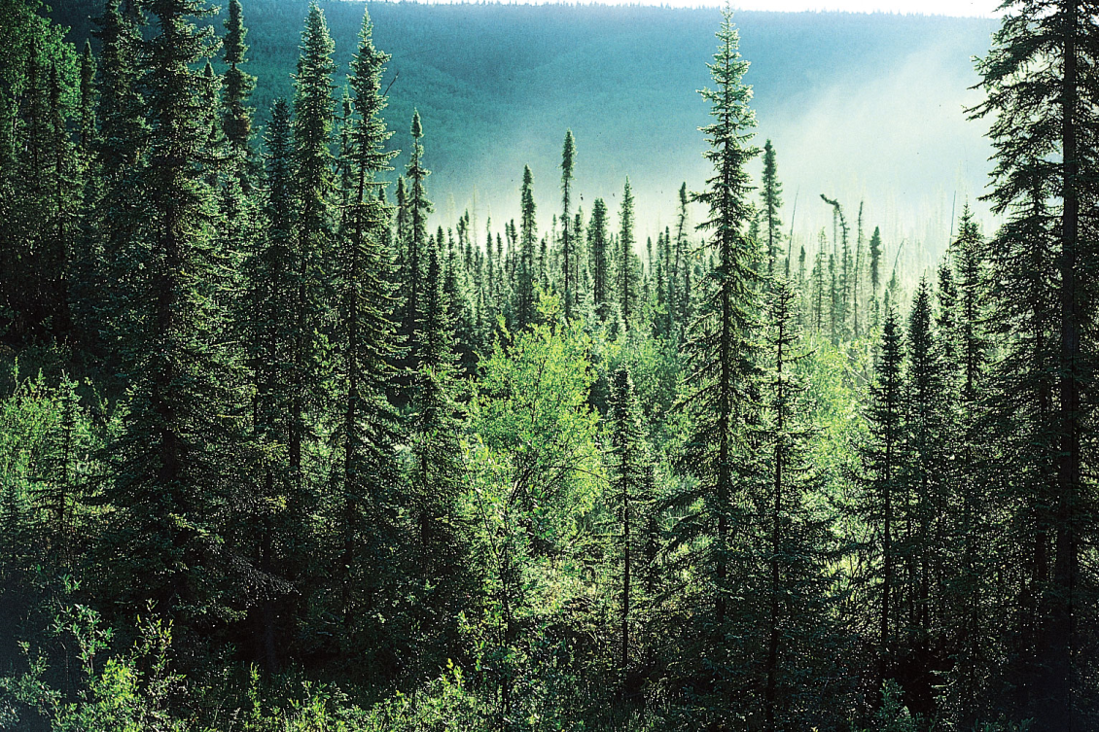

Slide 6
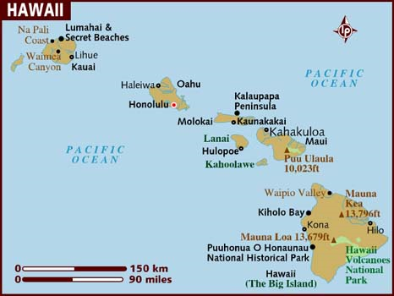
HAWAII
Late 1800’s- Americans who had set up sugar and pineapple plantations owned most of the land and businesses in Hawaii
Hawaiian’s were unhappy
Queen Liliuokalani wanted power and land returned to native Hawaiians
1893- Wealthy Americans led a revolt and forced the queen from power
Americans in Hawaii asked to join the U.S.
1898- became a U.S. territory
1959- became the 50th state

Slide 7
The Spanish American War
1898- U.S. Navy ship Maine exploded in Havana harbor, Cuba
American newspapers blamed Spain
President McKinley asked Congress to declare war on Spain
U.S. Navy sank most of Spain’s fleet in the Battle of Manila Bay in the Philippines
War shifted to Cuba
The Spanish-American war in 1898 saw the US take control of three key territories:
Cuba: Destruction of USS Maine in Havana provokes war with Spain. US invades Cuba, captures Havana on 20 September 1898
Philippines: Spain cedes control of the islands to the US
Puerto Rico: To deny Spanish ships a base in the Caribbean, US invades the island, captures the island 12 August

Slide 8
The Maine Exploded in Cuba’s Harbor

Slide 9
Battle of Manila Bay

Slide 10
Roosevelt and the Rough Riders
Theodore Roosevelt, Assistant Secretary of the U.S. Navy, supported imperialism (the building of empires by adding colonies)
He quit his job and formed the Rough Riders, a voluntary group that went to Cuba to fight
They were joined by the Buffalo Soldiers, a group African American soldiers
The Rough Riders and Buffalo Soldiers won the famous battle- The Battle of San Juan Hill
1898- Spain surrendered and gave Puerto Rico, the Philippines, and Guam to the U.S.
Cuba became independent

Slide 11
Battle of San Juan Hill

Slide 12
Panama Canal
1901- Theodore “Teddy” Roosevelt became President
Wanted to build a canal to reduce the time it took ships to get from the east coast to the west coast of the U.S.
Isthmus of Panama was narrowest place in Central America
Panama was part of Colombia
Colombia would not allow U.S. to buy land
Roosevelt helped people of Panama win independence from Colombia
New leaders of Panama allowed U.S. to build the Panama Canal
Building the canal was difficult, dangerous, and expensive
Took 10 years to complete Opened in August 1914
Took ships weeks instead of months to travel from the east coast to the west coast

Slide 13
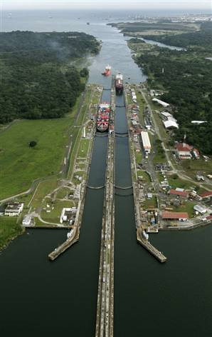
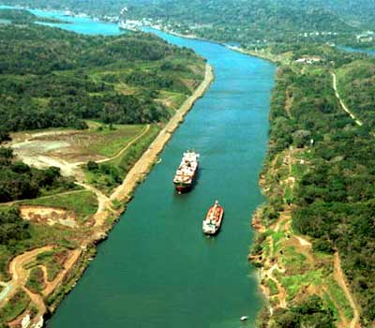
Panama Canal

