Slide 1
Chapter 9 Lesson 2 :World War I (pgs. 304-309)
Time period
1914-1917

Slide 2
Causes of the War
Nationalism, the belief that your country deserves more success than other, caused countries such as Germany, Russia, and France to compete for land and power

Slide 3
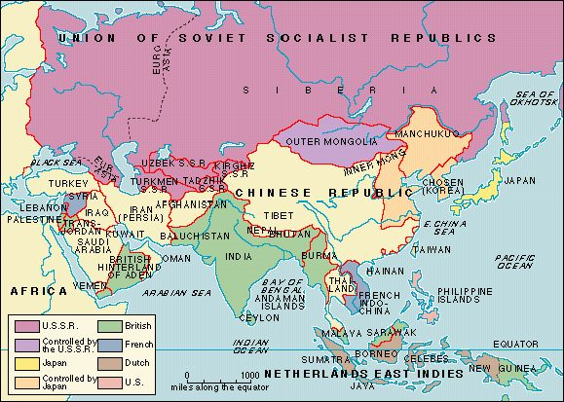
Causes of the War
Other countries started colonies around the world (imperialism)

Slide 4
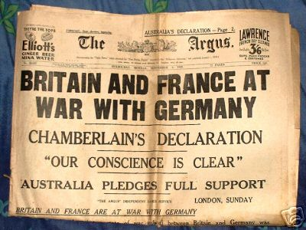
Causes of the War
To protect their empires they built up their armies and navies (militarism) in an effort to frighten or defeat other countries

Slide 5
The War BEGINS!
European countries began to form alliances, an agreement nations make to support and defend each other
Central Powers
vs.
Allied Alliance (Allies)

Slide 6
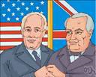
Allied Alliance - a.k.a.Allies
Russia
France
Great Britain
Italy
Portugal
Greece
Serbia
Romania
Montenegro
United States (1917)

Slide 7
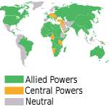
Central Powers
Austria-Hungary
Germany
Bulgaria
Ottoman Empire

Slide 8
What happened…
1914- Austria-Hungary declared war on Serbia
Serbia had an alliance with Russia, so Russia fought on Serbia’s side
Germany invaded France- France was also aligned with Russia
WWI BEGAN!

Slide 9
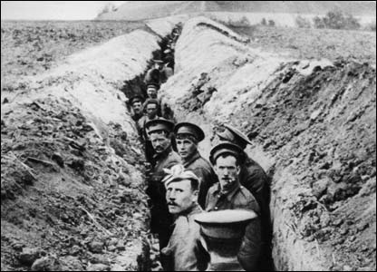
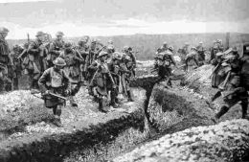
The Battlefield
Soldiers fought from trenches, long narrow ditches (trench warfare)
Soldiers live in trenches day and night
Soldiers braved mud, cold weather, and rats
Millions of soldiers were killed
Fighting lasted 4 years

Slide 10
U.S. Enters the WAR!
1914- U.S. remained neutral (stayed out of war)
1915- German submarine sank the Lusitania, a British passenger ship with many Americans on board
Germans promised not to attack passenger ships
1917- Germany broke promise and began attacking U.S. ships
April, 1917 U.S. declared war on the Central Powers
U.S. entered on the side of the Allies

Slide 11
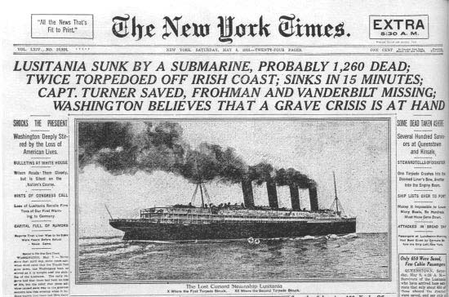

Slide 12
New Weapons used in WWI
Machine guns-shot hundreds of bullets each minute
Hand grenades- small bombs
Cannons- could hit targets miles away
Submarines- sank ships in the Atlanta Ocean
Tanks- could attack across land between the trenches (invented by British)
Poison gas- used to harm and kill
Airplanes- used later in the war to drop bombs
Most destructive war in history at the time

Slide 13
New Weapons
Machine Guns
Hand Grenades

Slide 14
New Weapons
Cannons
Submarines

Slide 15
New Weapons
Tanks
Poison Gas

Slide 16
Eddie Rickenbacker- US hero

Slide 17
Manfred Von Richthofen- German also known as The Red Baron

