Slide 1
Chapter 9 Lesson 3 Americans and the War (pgs. 312-317)
Time Period: 1917-1920

Slide 2
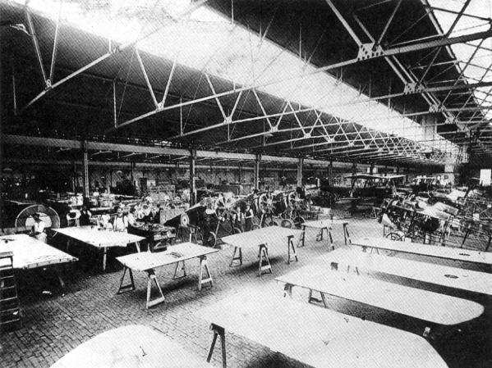
The Home Front
Many supplies were needed to fight the war
The U.S. produced more war supplies than any other country had before

Slide 3
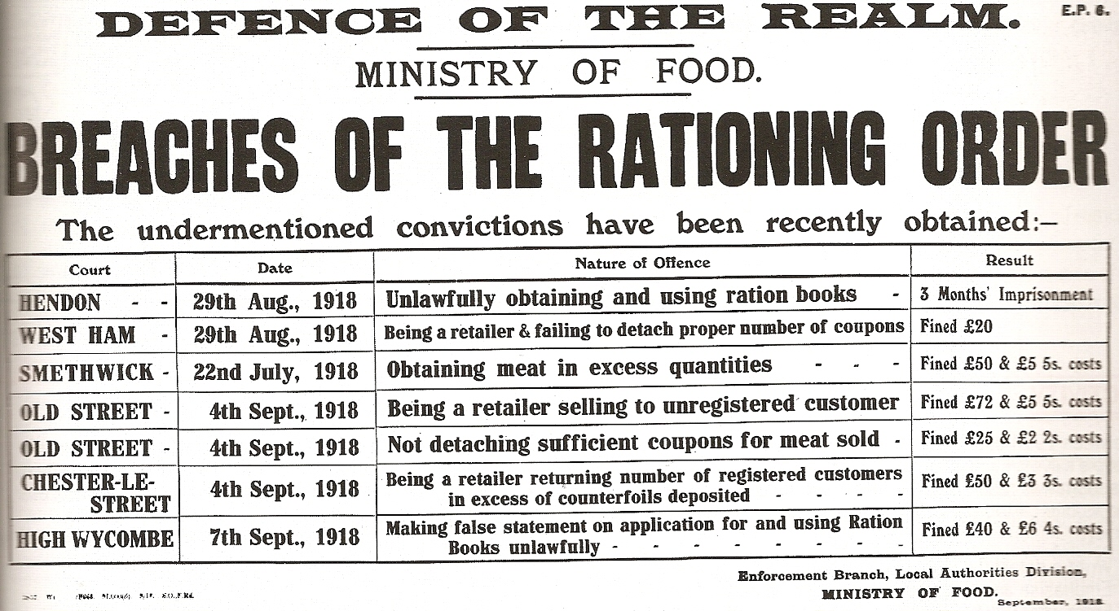
The War Effort
The government rationed items such as meat- limited the amount consumers could buy of certain items
Video, click here.

Slide 4
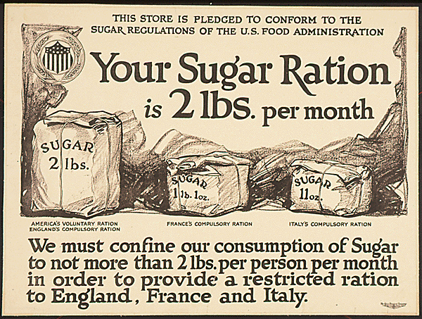

Slide 5
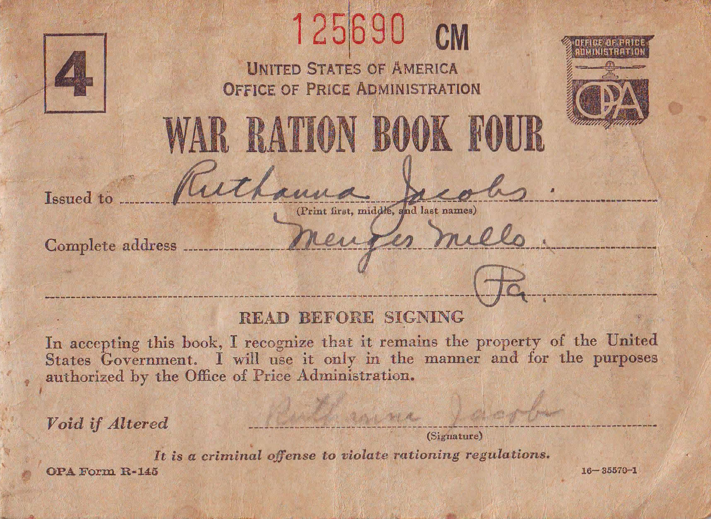

Slide 6
Propaganda
Propaganda reminded civilians to help with the war effort
Video, click here
Information used to shape people’s thinking was used by the government

Slide 7
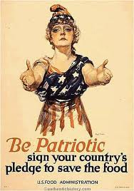
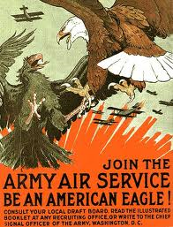
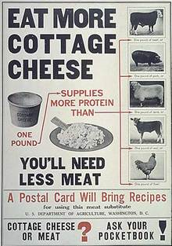

Slide 8
Factories and Supplies
Items not used by civilians could be used by soldiers
Factories needed workers to make supplies
African-Americans moved to northern cities to work in factories
Earned respect but still faced prejudice
Video click -- here

Slide 9
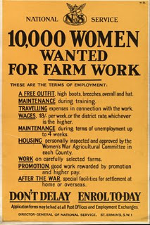
Women in the Workforce
Women took jobs that were usually held by men
Made weapons
Repaired cars
Delivered mail
Directed traffic
People’s opinion of women changed
1919- Senate passed 19th Amendment-
gave women the right to vote
1920- 19th amendment approved by states
Video, click here , and here

Slide 10
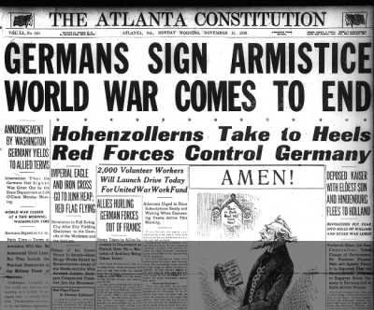
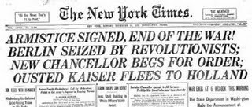
The War Ends
November 11, 1918- WWI ends
Central Powers signed an armistice- an agreement to stop fighting

Slide 11
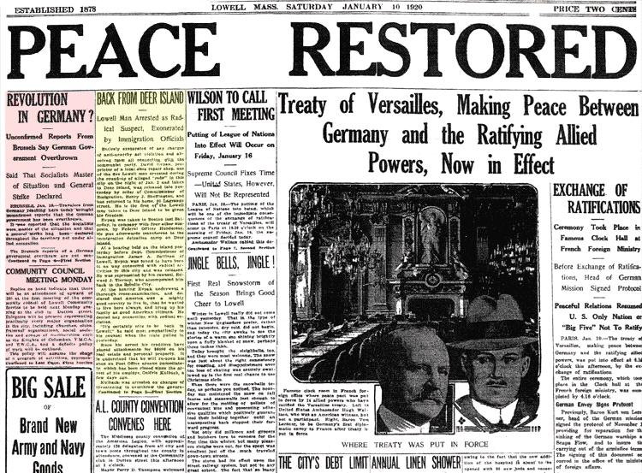
The Treaty of Versailles
Written in January 1919 and Ended the war
Allies used the treaty to punish Germany
Germany lost colonies
Gave land the France
Germany paid money
to Allied countries

Slide 12
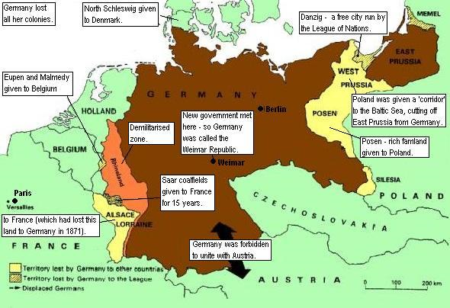

Slide 13
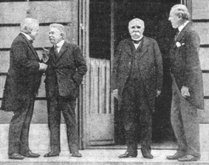
League of Nations
Would try to solve world problems peacefully
Members would also protect each other if war did start
Video, click here

Slide 14
US Senate did not approve the treaty
Afraid the US would be pulled into future wars
Americans began to believe in isolationism- stay out of world events
Video, click here then here

