Slide 1
Civil Rights Movement
Civil rights: right to vote, right to equal treatment, right to speak out

Slide 2
Civil War
Fought against slavery
At end of Civil War:
13th Amendment: slavery illegal
14th Amendment:
15th Amendment:

Slide 3
Life in 1950s
Segregation: separation of people with different races or ethnic backgrounds
Segregation in…
Schools
Buses
Bathrooms
Restaurants

Slide 4
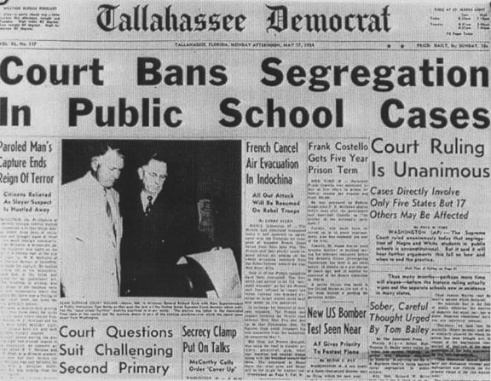
Brown vs. Board of Education
Segregation of schools
Linda Brown, a 3rd grader, lived in Topeka, Kansas
Education wasn’t as good at the segregated schools
Case went to Supreme
Court

Slide 5
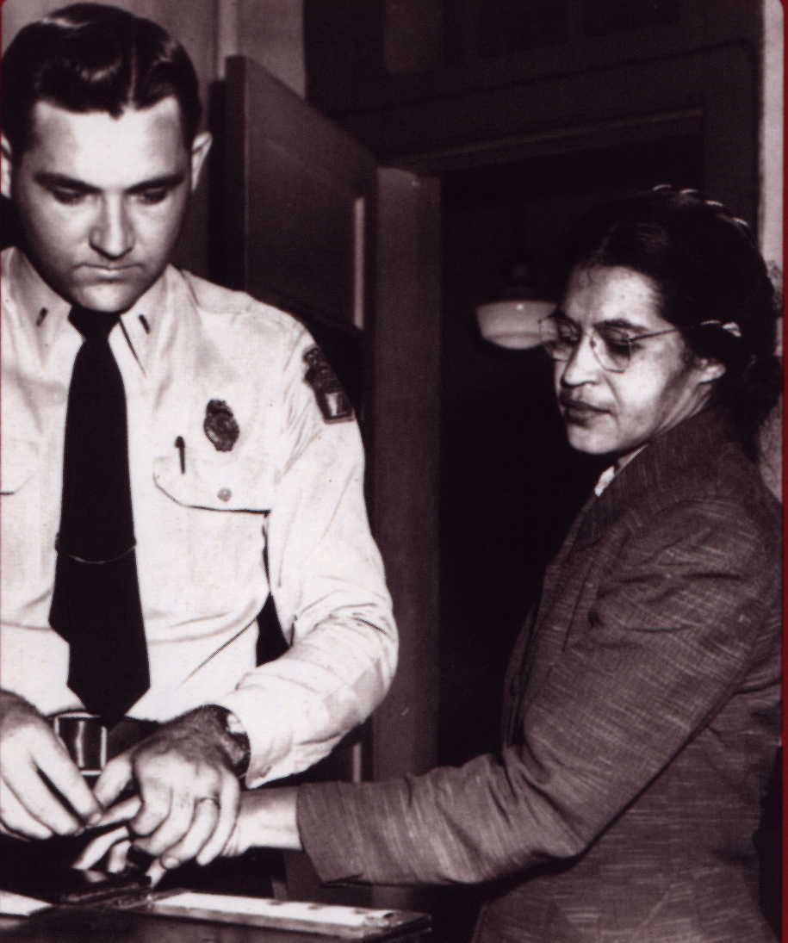
Montgomery Bus Boycott
Montgomery, Alabama
Rosa Parks, a 42 year old woman, just finished working at a department store
She paid her fare, and sat down in the “black section” of the bus
After the “white only” section filled, she was ordered to give her seat to a white person…and she refused

Slide 6
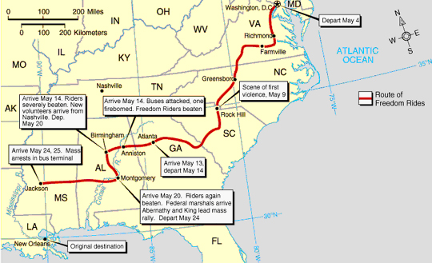
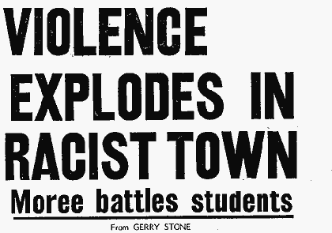
Freedom Riders
Rode buses through segregated United States.
Wanted to test new laws against segregation
People against segregation attacked and arrested Freedom Riders.

Slide 7
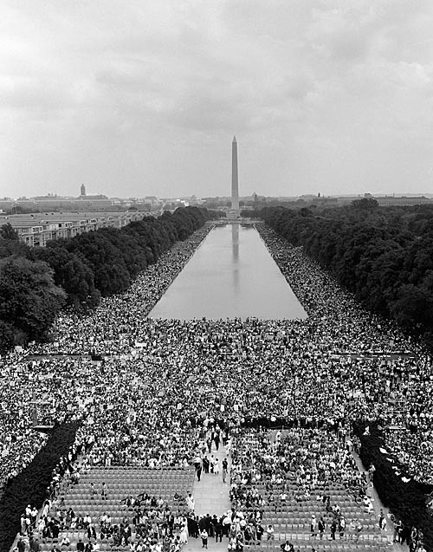
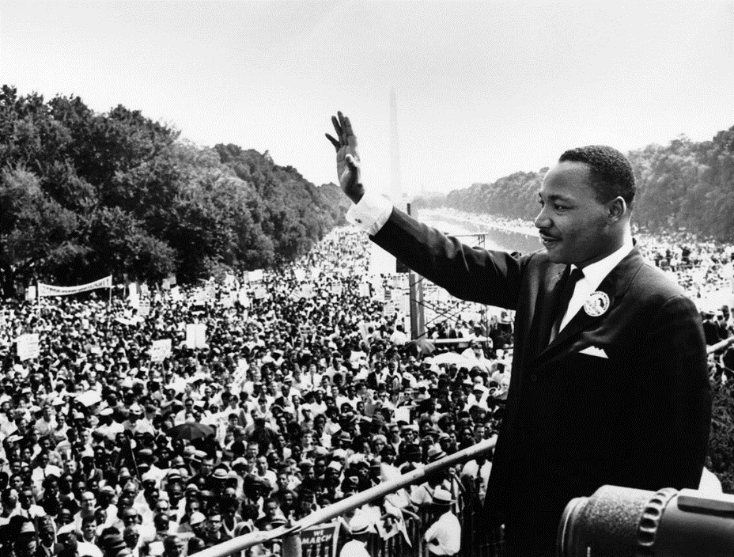
March on Washington
Wanted to support a new bill to end segregation.
Martin Luther King, Jr. gave “I Have a Dream” speech

Slide 8
Gains and Losses
Civil Rights Act of 1964– banned segregation in schools, workplaces, and public places such as restaurants and theaters
Voting Rights Act in 1965—made it illegal to prevent or hinder citizens from voting because of their racial or ethnic background

Slide 9
Gains and Losses (cont’d.)
Sadly, Martin Luther King Jr was assassinated in 1968
MLK Jr’s work encouraged Mexican American and Women’s groups to fight for equal rights as well

