Slide 1
GEORGIA MILESTONES REVIEW
Practice for all subject areas
Created March 2016

Slide 2
ELA GA MILESTONES REVIEW

Slide 3
Which sentence shows the correct way to write the title of a book?
A. During the summer I read a great novel, Because of Winn-Dixie.
B. During the summer I read a great novel, BECAUSE OF WINN-DIXIE.
C. During the summer I read a great novel, Because of Winn-Dixie.
D. During the summer I read a great novel, “Because of Winn-Dixie.”

Slide 4
Correct Answer: C
Explanation of Correct Answer: The correct answer is choice (C) During the summer I read a great novel, Because of Winn-Dixie. Underlining or italics are appropriate for book titles. Choice (A) does not show the reader that Because of Winn-Dixie is a title. Choice (B) uses all caps, which is not correct for a book title. Choice (D) uses a format that would be appropriate for a short story but not for a novel.

Slide 5
Which sentence uses commas correctly?
A. “Jason, you called last night, didn’t you?”
B. “Yes it was me, I did phone you, last night.”
C. “There goes your little sister Nathaniel,” I said.
D. “No she is home sick today,” Nathaniel replied.

Slide 6
The correct answer is choice (A) “Jason, you called last night, didn’t you?”
Choices (B) and (D) are incorrect because “yes” and “no” require commas after them. Choice (C) is incorrect because it needs a comma before “Nathaniel.”

Slide 7
Which of these BEST combines the sentences into one clear statement?
Richard went to a museum. It was his first museum visit. He was amazed by the variety of items. He was also amazed by the quality of items.
A. Having never visited a museum before, Richard was amazed by the variety and quality of the items.
B. The quality and variety of items at the museum amazed Richard during his first trip to a museum.
C. Because he was impressed by the quality of items and their variety, Richard visited a museum.
D. Both the quality and variety of items impressed Richard at the museum for his first visit.

Slide 8
The correct answer is choice (A) Having never visited a museum before, Richard was amazed by the variety and quality of the items. Choice (B) is incorrect because it repeats “museum.” Choice (C) is incorrect because it shows an inaccurate cause and effect relationship. Choice (D) is incorrect because the prepositional phrases create an awkward, unclear construction.

Slide 9
Which revision of sentence 3 makes the verb tense consistent with the rest of the paragraph?
(1) Animals need to visit their doctors regularly. (2) Veterinarians administer shots regularly to keep pets healthy. (3) They also check pets’ teeth, just like dentists, to make sure they had no dangerous plaque. (4) Veterinarians can even provide grooming services to keep your pet’s nails at a comfortable length.
A. They also would check pets’ teeth, just like dentists, to make sure they had no dangerous plaque.
B. They also checked pets’ teeth, just like dentists, to make sure they have no dangerous plaque.
C. They also check pets’ teeth, just like dentists, to make sure they have no dangerous plaque.
D. They also check pets’ teeth, just like dentists, to make sure they had no dangerous plaque.

Slide 10
The correct choice is choice (C) They also check pets’ teeth, just like dentists, to make sure they have no dangerous plaque. Sentence 3 is written in the present tense, and “have” is present tense. Choice (A) is incorrect because “would check” is future tense. Choice (B) is incorrect because “checked” is past tense. Choice (D) is incorrect because “had” is past tense.

Slide 11
Which sentence uses the underlined word as a preposition?
A. Derrick always forgets to bring his winter gloves.
B. Jasmine called to ask if I wanted to come over later.
C. While visiting your cousin, complete your homework.
D. Iris decided to walk home with her friends after school.

Slide 12
The correct choice is choice (D) Iris decided to walk home with her friends after school. “With her friends” is a prepositional phrase. Choice (A) is used as an infinitive. Choice (B) has an adverb underlined, and choice (C) has a subordinating conjunction underlined.

Slide 13
MATH GA MILESTONES REVIEW

Slide 14
Look at these two numbers:
563 436
How much greater is the digit 6 in 563 than the digit 6 in 436?
A. 6 times greater
B. 10 times greater
C. 60 times greater
D. 100 times greater

Slide 15
Correct Answer: B
Explanation of Correct Answer: The correct answer choice is (B) 10 times greater.
The digit 6 is in the tens place in 563 and in the ones place for 436. The value of the
same digit in the tens place is always ten times greater than the value of that digit
in the ones place. Choice (A) is incorrect because it shows a lack of understanding of
place value. Choice (C) is incorrect because it shows the value of the digit in 563, but
this does not compare the value of the digit in the two numbers. Choice (D) is incorrect
because it shows what the difference would be if the digit 6 were in the hundreds place
rather than the tens place.

Slide 16
Evaluate these two expressions.
a) (7 + 5) × 4
b) 7 + 5 × 4
Part A: Which expression has a greater value—a or b?
Part B: Explain why this expression has a greater value.

Slide 17
Correct Answer: a
Explanation of Correct Answer: The correct answer is choice (a). This expression has a value of 48, which is greater than choice b, which has a value of 27. Expression (a) has parentheses around 7 and 5, so you have to add these numbers first to find a sum of 12. Next you multiply the sum 12 by 4. The total value is 48. For the second expression, there are no parentheses. The order of operations states that you perform operations in parentheses first. If there are no parentheses in an expression, multiplication comes before addition. For expression (b), you must multiply 5 times 4, which is 20. Next you add 7, which is a total of 27.

Slide 18
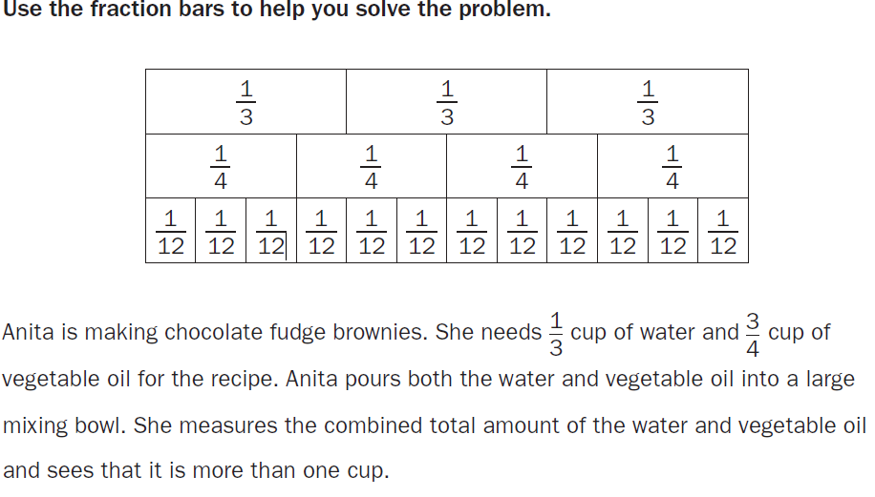
Part A: How much more than one cup is Anita’s mixture of water and vegetable oil?

Slide 20
Part B: How could Anita know, without measuring, that 1/ 3cup of water and 3/ 4cup of oil together is less than 2 cups?

Slide 24
There are 14 students making sculptures with craft sticks. There are 644 craft sticks in a box. Each student gets an equal number of craft sticks.
Part A: Explain each step needed to determine the maximum number of craft sticks that each student can get.

Slide 25
Because there is a total of 664 matches and there are 14 people. You must take the total you have of the item and divide it by how many groups you need to make. The answer in the box should be 46. Each person can use 46 matches.

Slide 26
Which expression has a total value of 40?
A. 3 + 2 × (13 − 5)
B. 3 + 2 × 13 − 5
C. (3 + 2) × (13 − 5)
D. (3 + 2) × 13 − 5

Slide 28
Rita wants to find the number that is 3 times as large as the sum of 5 and 7.
She writes this expression: 3 × 5 + 7.
Part A: Explain why Rita cannot use this expression to find the number.
Part B: How could Rita change the expression to find the correct number?

Slide 29
Part A: If you use PEMDAS to solve her problem, you would first multiply 3 x 5. You would get 15. Then you would add 7. However, the questions says 3 times the SUM of 5 and 7. This means you need to first add 5 and 7 THEN multiply it by 3.
Part B: the correct equation would be 3 (5 +7)

Slide 30
Part A: What is the total number of miles each person rode?
Part B: Explain how the models illustrate the problem and answer.

Slide 31
Part A: Each person rode 2.9 miles each.
Part B: Each person has 2 hundreds grids filled in and the 0.9 of the last one. If you add up 2.9 + 2.9 + 2.9, or 2.9 x 3, you will get 8.7.

Slide 34
What is 5.816 rounded to the nearest tenth?
A. 5.8
B. 5.82
C. 5.9
D. 6.00

Slide 35
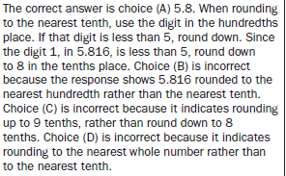

Slide 37
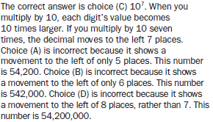

Slide 39
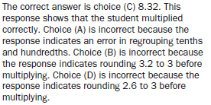

Slide 41
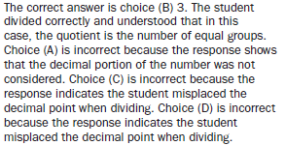

Slide 43
60 divided by 8 is 7.5 pounds. Therefore, answer C is correct 7 ½ pounds.

Slide 45
C. 23/24

Slide 51
Part A: Row A: (1, 2)
Row B: (2, 4)
Row C: (3, 6)
Row D: (4,8)
Row E: (5, 10)
Part B: Y is double X

Slide 53
C. (8, 2)

Slide 57
D. Both figures have at least one pair of parallel lines.

Slide 58
Part C: What other name could you give this figure?

Slide 59
Part A: Parallelogram
Part B: It has four sides, it has two pairs of congruent angles, it has two sets of parallel lines, and has two sets of congruent lines.
Part C: Quadrilateral

Slide 62
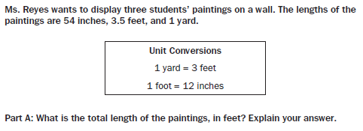

Slide 63
Part A: 11 feet. 54 inches is equal to 4.5 feet. 1 yards is equal to 3 feet. Therefore, 4.5 + 3 + 3.5 = 11 feet
Part B: 132 inches. Using the answer of 11 feet from part A, if you multiply that by 12, because 12 inches are in one foot. 11 x 12 = 132.

Slide 65
With the formula Volume = (Area of Base) x ( height)
That means Volume = (8 x 2) x (3) = 48 units
Therefore D. 48 is correct

Slide 66
SCIENCE GA MILESTONE REVIEW

Slide 67
Which of these BEST describes the function of the cell membrane?
A. It produces energy for cell functions.
B. It is responsible for cell reproduction.
C. It controls what enters and leaves the cell.
D. It stores water and nutrients until needed by the cell.

Slide 68
Correct Answer: C
Explanation of Correct Answer: The correct answer is choice (C) It controls what enters and leaves the cell. Choice (A) is incorrect. Energy is manufactured elsewhere in the cell. Choice (B) is incorrect because the membrane is not responsible for cell reproduction. Choice (D) is incorrect because the function of storing materials is done elsewhere in the cell.

Slide 69
A teacher is demonstrating physical and chemical changes to her class.
Which action should she use to demonstrate a chemical change?
A. cutting a piece of paper
B. folding a piece of paper
C. tearing a piece of paper
D. burning a piece of paper

Slide 70
Correct Answer: D
Explanation of Correct Answer: The correct answer is choice (D) burning a piece of paper. Chemical changes occur when matter is changed from one form to another without creating a new substance. When paper is burned, new substances (smoke and ash) are created. Choices (A), (B), and (C) are incorrect because they all represent physical changes. The paper is changed, but a new substance is not created.

Slide 72
Correct Answer: C
Explanation of Correct Answer: The correct answer is choice (C) The temperature of the water inside the glass is colder than the air outside the glass. The cold temperature on the outside of the glass causes the water vapor on the outside of the glass to form liquid water on the surface of the glass. Choices (A) and (B) are incorrect. The humidity level is not as important to the formation of water vapor as the lower temperature. Choice (D) is incorrect because water vapor would not form on the outside of a glass that is warmer than the air that surrounds the glass.

Slide 74
The correct answer is choice (C) It controls the activities of the cell. The nucleus is found in both cells. It controls the functions of the other cell parts including moving, eating, and reproducing. Choice (A) describes the cytoplasm, which is the fluid that fills the cell and protects the parts of the cell. Choice (B) describes the cell wall, which is found only in the plant cell. Choice (D) describes the cell membrane in a plant and an animal cell.

Slide 75
In the 1670s, Antony Leeuwenhoek discovered microorganisms in the human mouth. Later these microorganisms were determined to cause dental plaque, which is harmful to teeth.
Which of these describes another way microorganisms can be harmful?
A. Microorganisms act on milk to make yogurt.
B. Microorganisms break down dead organisms.
C. Microorganisms break down meat before it is eaten.
D. Microorganisms break down sugars in your digestive system.

Slide 121
SOCIAL STUDIES GA MILESTONES REVIEW

Slide 122
Who was the president of the Confederacy?
A. Robert E. Lee
B. Jefferson Davis
C. Ulysses S. Grant
D. Abraham Lincoln

Slide 123
Correct Answer: B
Explanation of Correct Answer: The correct answer is choice (B) Jefferson Davis. Davis was the president of the Confederate States of America. Choice (A) is incorrect because Lee was a Confederate general, not a political leader. Choice (C) is incorrect because Grant was a Union general, not a Confederate leader. Choice (D) is incorrect because Lincoln was the president of the United States, not the Confederacy.

Slide 124
How does the 17th Amendment help maintain a representative democracy?
A. by allowing only elected officials to choose the senators
B. by preventing senators from voting more than once on each law
C. by having the public choose their senators by voting for them in elections
D. by keeping the number of senators equal to the number of representatives

Slide 125
Correct Answer: C
Explanation of Correct Answer: The correct answer is choice (C) by having the public choose their senators by voting for them in elections. The 17th Amendment established the direct election of senators by popular vote. Before the amendment, senators had been chosen by state legislators. Choice (A) is incorrect because elected officials do not choose senators. Choice (B) is incorrect because it does not explain the purpose of the amendment. Choice (D) is incorrect because there are more members in the House of Representatives than there are in the Senate.

Slide 135
The correct answer is (C) the Battle of Fort Sumter. The South believed it was their military base because it was in Charleston, South Carolina—and South Carolina had succeeded from the Union. However, the Union felt the base was theirs because they had built it and provided all of the supplies.

Slide 164
THE END…. NOW GO ROCK THE TEST!!!! ☺

