Slide 1
Life in the 1960s
Space Race and Vietnam War

Slide 2
The Kennedy years
1960, JFK was the YOUNGEST President ever elected
Famous for saying, “ask not what your country can do for you—ask what you can do for your country”
Created the “New Frontier” Programs to improve life and get the young people to help
Peace Corps-sent volunteers to teach children, grow food, and start businesses in countries around the world

Slide 3
The space race
A competition between the US and the Soviet Union to send people to outer space
In 1957, the Soviet Union “won” by sending Sputnik I into outer space
In 1961, the Soviet Union also sent the first person into space, Yuri Gagahin, he orbited the earth in a space capsule
Alan Shepard was the first American to go to outer space
John Glenn (American) orbited the earth in Friendship 7
On July 20th, 1969, Neil Armstrong and Buzz Aldrin landed on the moon

Slide 4
A changing Nation
Kennedy was assassinated in 1963, therefore, he didn’t see the moon landing
Vice President Lyndon B. Johnson was sworn in as President when Kennedy was killed
Johnson created the “Great Society” program– he wanted to end poverty
Welfare was created– a program that helps people who are in need
The program provided food, shelter, and medical care for people who couldn’t pay
It helped with education and job training

Slide 5
A changing Nation (cont’d)
Robert F. Kennedy (John’s brother) ran for President in 1968
He supported civil rights and aid for the poor
He as assassinated during the campaign
Many were in shock after both he, his brother, and MLK Jr had all been killed

Slide 6
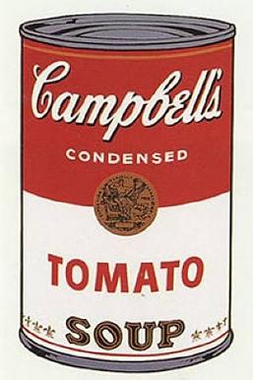
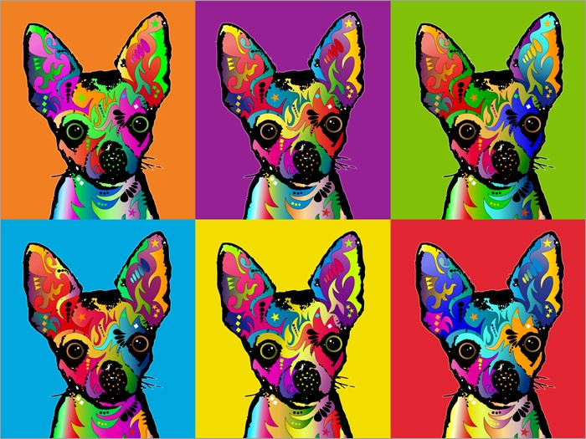
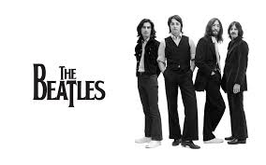
1960’s Culture
Rock n’ Roll
“Pop Art”
Andy Warhol– showed that advertisements had too much influence on people

Slide 7
War in Vietnam
Vietnam was a French colony until it won its independence in 1954
It split into North Vietnam (Communist) and South Vietnam (non-communist)
The Vietcong (a communist group in South Vietnam) tried to overthrow South Vietnam’s government
North Vietnam supported the Vietcong group
The United States supported South Vietnam with supplies and advisors…. And eventually soldiers

Slide 8
Fighting Increases
President Lyndon B. Johnson send troops to help South Vietnam
We had advanced technology, tanks, bombers, and helicopters to move soldiers quickly
Vietcong fight in small groups and did not have advanced resources
Even though the US had bigger and more powerful weapons—the Vietcong controlled most of South Vietnam

Slide 9
Getting Out of Vietnam
President Richard Nixon began bringing troops home when he got into office in 1969
US bombing of North Vietnam and Cambonia INCREASED
In 1973, the US and both North and South Vietnam agreed to a “cease-fire”
Once US soldiers were out of Vietnam, North Vietnam began attacking South Vietnam and eventually took it over….

Slide 10
The antiwar movement
Television allowed people at home to see exactly what was going on in Vietnam
People felt strongly either for OR against the US fighting in the war
Anti- war protesters held a demonstration outside the United Nations in New York City to speak out against the war

