Slide 1
Reconstruction
Chapter 6, Lesson 4

Slide 2
Plans for Reconstruction
After the Civil War, the country needed to be united
The period when the south rejoined the Union was called Reconstruction
There were many different opinions and how to bring the south back into the Union
Many Americans wanted to punish the south, while others wanted to make it easy for the south to rejoin
President Lincoln did not believe in punishing the south

Slide 3
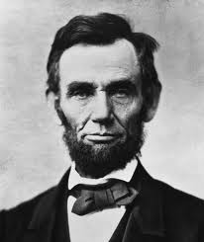
President Lincoln
“With malice [meanness] toward none, with charity for all. . . Let us strive on [try] to finish the work we are in, to bind up the nation’s wounds”

Slide 4
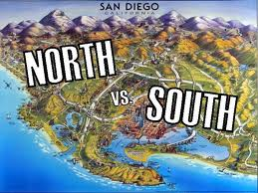
President Lincoln’s Plan for Reconstruction
Let southern states set up new governments
Allow the southern states to rejoin the Union quickly

Slide 5
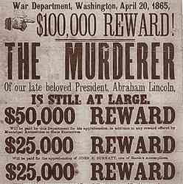
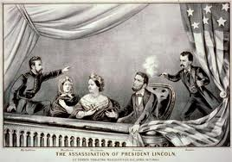

Lincoln’s Death
Lincoln was shot on April 14th, 1865 by John Wilkes Booth (an actor who had supported the Confederacy)
Lincoln’s assassination shocked the nation
Lincoln was missed during the difficult years of Reconstruction

Slide 6
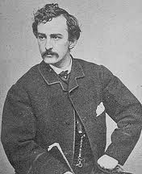
John Wilkes Booth

Slide 7
Effects of the Civil War on the South
Hundreds of thousands of people died
Ruined farms, cities, and factories
Freedom for enslaved people
Slaves did not have homes or jobs

Slide 8
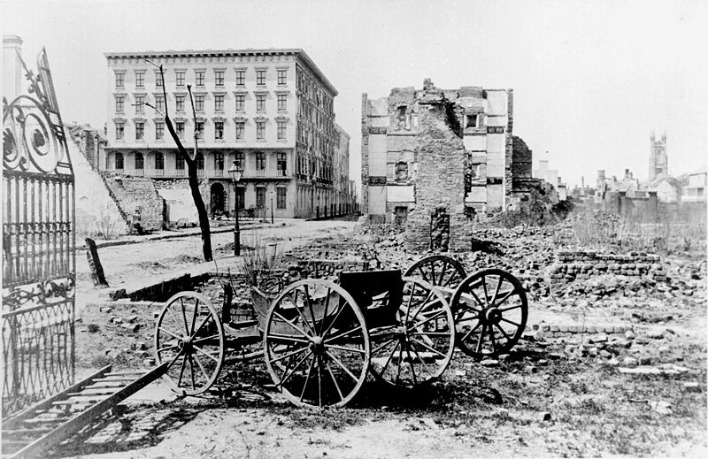
The ruins of Mills House and nearby buildings, Charleston, South Carolina, at end of the Civil War. A shell-damaged carriage and the remains of a brick chimney are in the foreground. - photo by George N. Barnard (1819 - 1902)

Slide 9
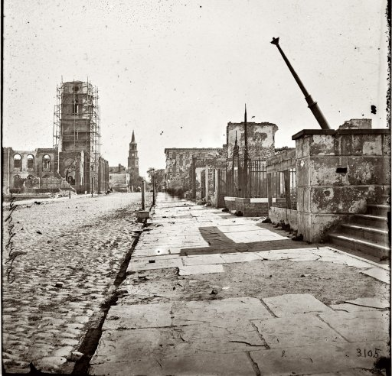

Slide 10
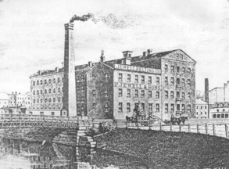
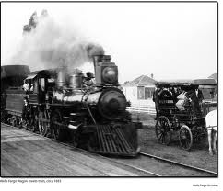
Effects of the Civil War on the North
The North grew stronger
There was little fighting, so the damages to the homes, businesses, and land were much less
Northern industries and railroads grew quickly during and after the war

Slide 11
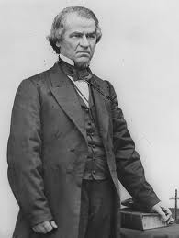
President Johnson
Vide President Andrew Johnson became president after Lincoln’s death
Johnson put Lincoln’s plan for Reconstruction into action in 1865

Slide 12
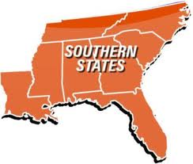
Changes in the South
The federal government forced the south to abolish slavery
The South was resistant to the changes
In 1867, Congress put the south under military control to be sure that they were giving rights to African-Americans

Slide 13

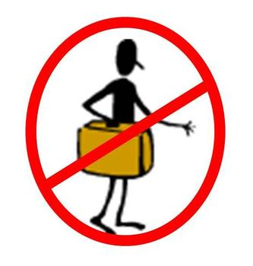
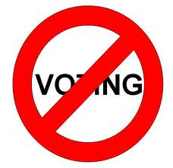
Changes in the South
The South continued to treat many African-Americans unfairly
They created harsh laws called, Black Codes, which limited the rights of former slaves to travel, vote, and work in certain jobs
Members of Congress decided to create the Freedman’s Bureau to help poor blacks and whites

Slide 14
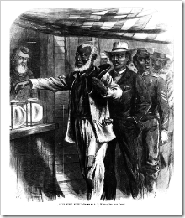

Slide 15


Freedman’s Bureau
Food
Clothing
Medical Care
Legal Advice
Set up hospitals and schools
Found jobs for many

Slide 16
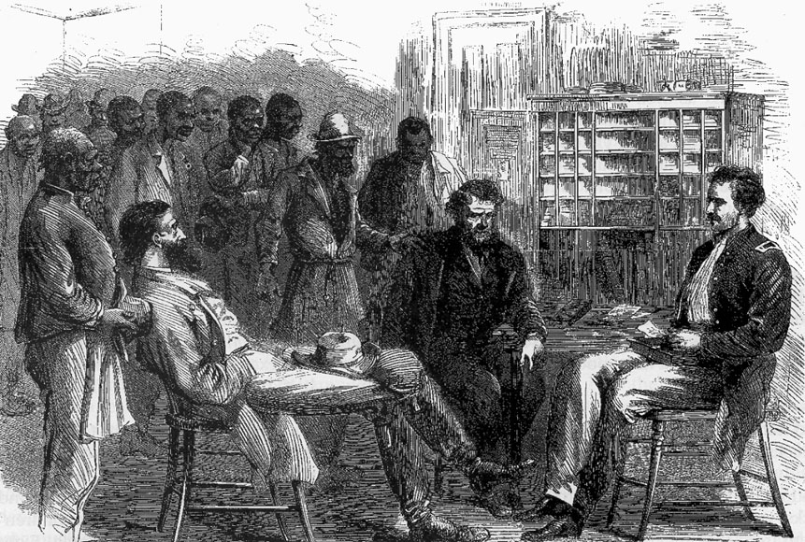

Slide 17
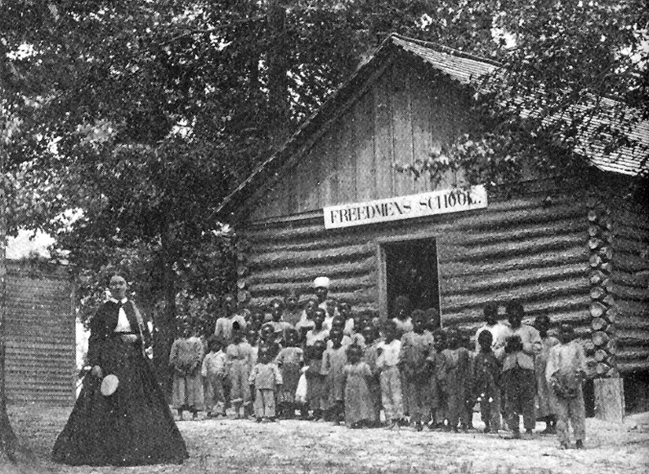

Slide 18
President Johnson is Impeached
In 1868, the House of Representatives voted to impeach President Johnson
Impeach- to charge a government official with a crime
Congress accused Johnson of breaking one of the new laws
Congress did NOT succeed in forcing Johnson out of office, so he finished his presidency

Slide 19
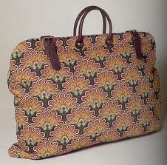
Carpetbaggers and Scalawags
Southerners who helped the government during Reconstruction were called Scalawags (slang for an old worthless horse)
Carpetbaggers were northerners who traveled to the south to try to make money (they were known for taking advantage of southerners.)
Many carpetbaggers carried suitcases made out of carpet-like material

Slide 20
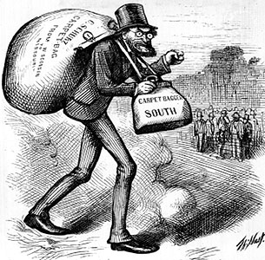

Slide 21
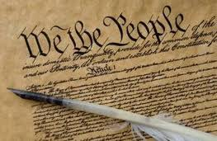
The Constitution Changes
During Reconstruction, Congress created three new amendments (changes) to the Constitution
The amendments gave the government more power over the states
They also helped protect the rights of African-Americans

Slide 22
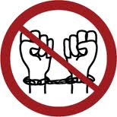
13th Amendment
Ended slavery throughout the United States

Slide 23
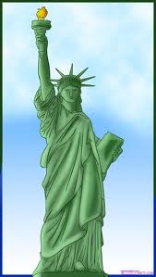
14th Amendment
Gave citizenship to African-Americans
It said that a citizen’s life, liberty, or property cannot be taken away without “due process of law” (a fair trial)
This amendment was created to reduce the effects of Black Codes in the south
The southern states did not want to ratify the 14th amendment, but they finally agreed so they could rejoin the Union

Slide 24
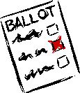
15th Amendment
Guaranteed African-American men the right to vote
As a result of the 15th amendment, many African-American men began taking part in the government
African Americans in state legislatures worked together to create the first public white schools for white and blacks in the south
16 African Americans joined the United States Congress

Slide 25
The Struggle for Rights Continues. .
Even though many new laws were passed, many people in the North and South still did not want African-Americans to have equal rights
Many times, the new laws were ignored
The struggle for equality would continue for African-Americans. . .

