Slide 1
WORLD WAR 1
AMERICANS IN THE WAR

Slide 2
ISOLATIONISM
THE POLICY WHERE AMERICA DOES NOT INTERFERE WITH OTHER NATIONS’ PROBLEMS
USA DOES NOT HELP ANY COUNTRIES THAT ARE AT WAR IN EUROPE

Slide 3
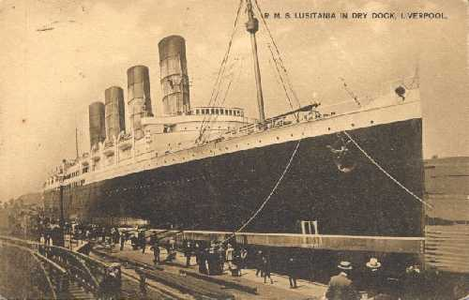
HOW AMERICA ENTERS THE WAR
1915- Germany sank Lusitania, killing 128 Americans!!
1917- Germany began attacking US ships

Slide 4
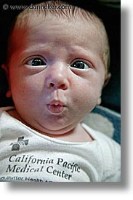
ZIMMERMAN TELEGRAM
1917- Germany sends a telegram to Mexico encouraging them to attack USA.
Germany wants to distract USA from war in Europe
USA intercepts it, and realizes Germany is not their friend.
That’s not very nice!

Slide 5
APRIL 6, 1917- USA joins Allied Powers
Allied Powers
USA
Great Britain
France
Russia
Central Powers
Germany
Austria-Hungary
Ottoman Empire

Slide 6
Now that we’re at war, what will US have to do?

Slide 7
Build armies and send soldiers to Europe.
Make weapons & supplies
- ships, trucks, pistols, helmets
-US made more supplies than any other country
Sent food to soldiers

Slide 8
What ways could American people help?
Fight in Europe
Work in factories
Save food to send to troops-
Rations- limits on food Americans could buy because soldiers needed food.

Slide 9
Propaganda
Posters used to shape people’s thinking- war posters.
Encourages people
to join Army.

Slide 10
People were mad at Germany after the Lusitania. This poster reminded people what Germany had done.

Slide 11
Women were important in the war, too.
Women took over men’s jobs when they left to fight in Europe.

Slide 12
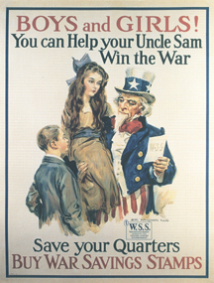
Even children
could help!
Every quarter
counts

Slide 13
Food needs to be saved to send to soldiers in Europe.

