Slide 1
World War I
PropAganda

Slide 2
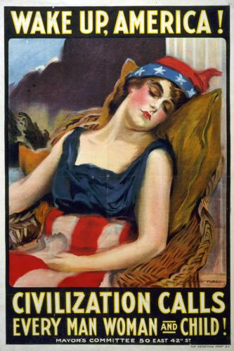
Everyone can help!!

Slide 3

Buy a war Bond to help pay for Bullets!

Slide 4

Even Little ones can help out!

Slide 5

Uncle SAM wants you!!

Slide 6
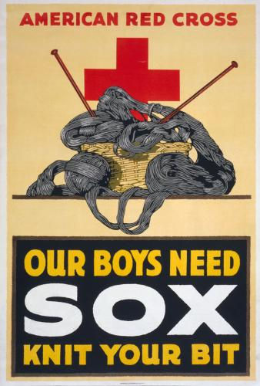
You can help by making things too!

Slide 7
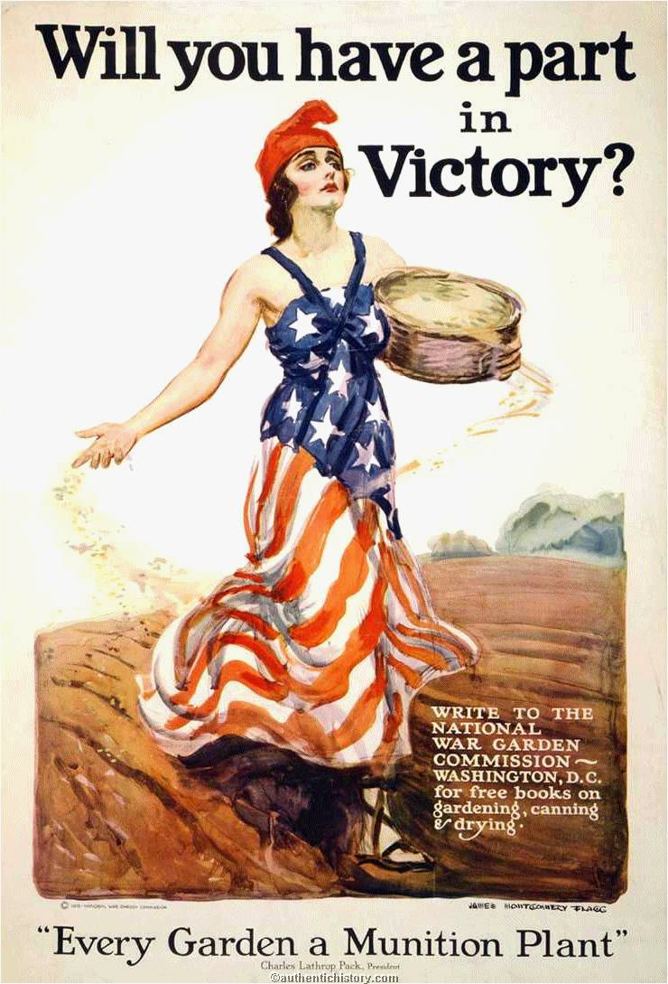
Grow a Garden and do your part!

Slide 8
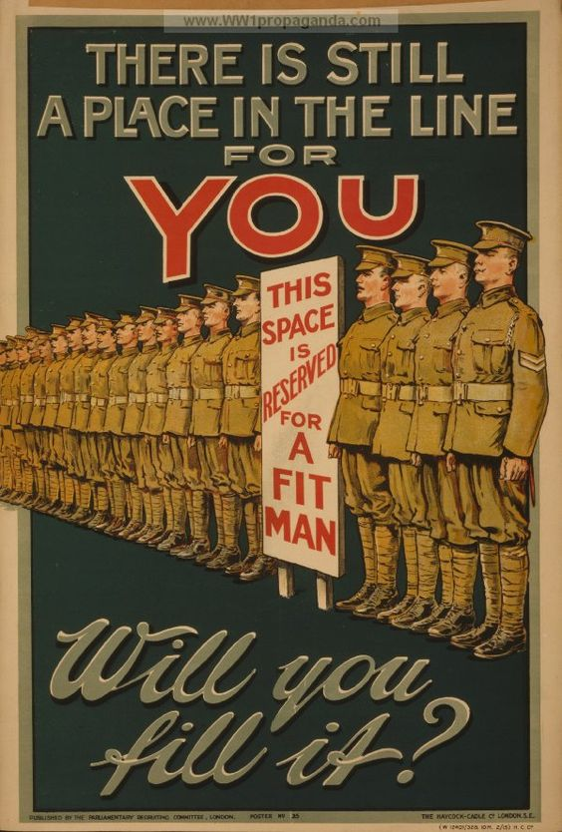
Will you do your part?

Slide 9

Grow your Victory Garden
( Hoover was Part of WWII not WW I—however both time periods promoted the concept)

Slide 10
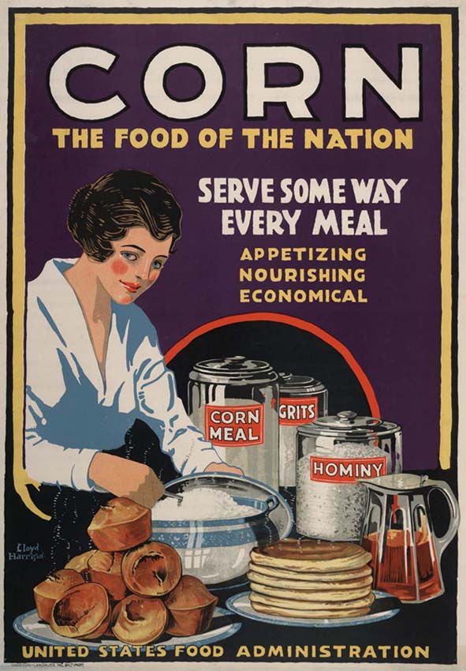
Use Corn meal so that we can send the Wheat to the Soldiers!

Slide 11

Don’t waste Bread!!

